Slide 1
Welcome to the “TiDB Cloud Quick Start”
If you _______ this workshop is for you:
Are new to TiDB
Want a FREE TiDB Cloud account
Want to understand TiDB architecture
Want hands-on experience with TiDB Cloud
Want to learn about the TiDB Cloud Playground
Have a laptop *
* It’s best to use a laptop, but it’s possible to do the exercises on a phone. Phone is much more difficult – slow going. You can watch what we do and do the hands-on portion later.
Notes:
This slide will be displayed while people enter the workshop. We want to let them know who this session is for. Letting them know beforehand enables them to attend a more appropriate session.
Call out that if you use a phone, we will be forced to leave you behind.

Slide 2
TiDB Cloud Quick Start
Jeff Bailey, PingCAP Education
Notes:
If you are presenting these slides, replace my name with yours. I would love to know that you used these slides. Tell me all about it – Jeff.Bailey@pingcap.com.

Slide 3
What will you get out of the TiDB Cloud Quickstart?
You will:
Create a Free TiDB Cloud Developer account
See Hybrid Transaction/Analytical Processing (HTAP) in action
Use TiDB Playground as your mad scientist laboratory
Know where to find free TiDB training.
Have everything you need to do something cool and unexpected!

Slide 4
Create a FREE TiDB Cloud Account
Notes:
If you want to do I live demo of this and you already have an account, you can put +test01 (or something similar) to your email address. For example: my.name+test01@mycompany.com.

Slide 5
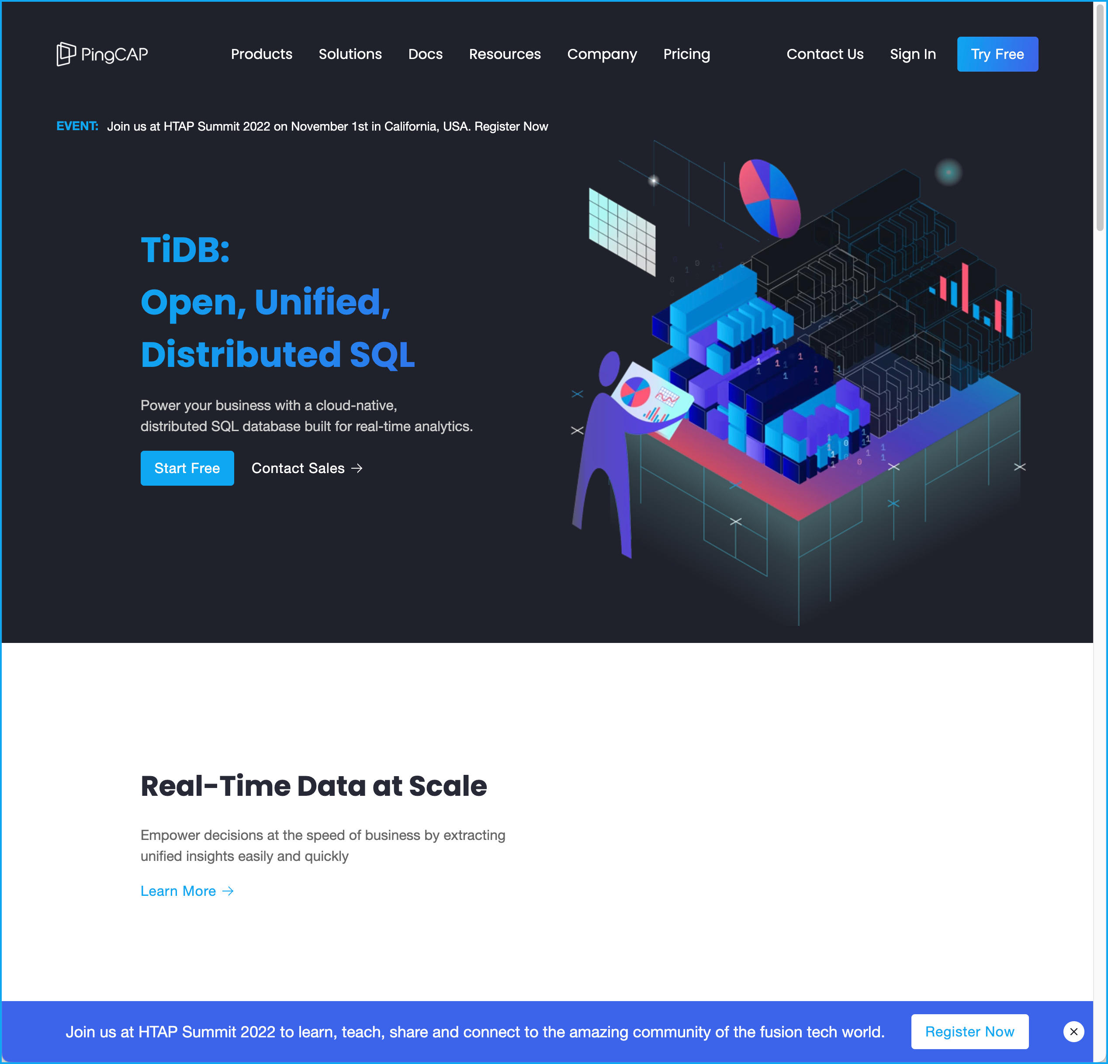
Create your FREE TIDB Cloud Account
Click Here
Go to pingcap.com
Notes:
Go to the pingcap.com site and click on ”Try Free.” You can go straight to “tidbcloud.com”.

Slide 6
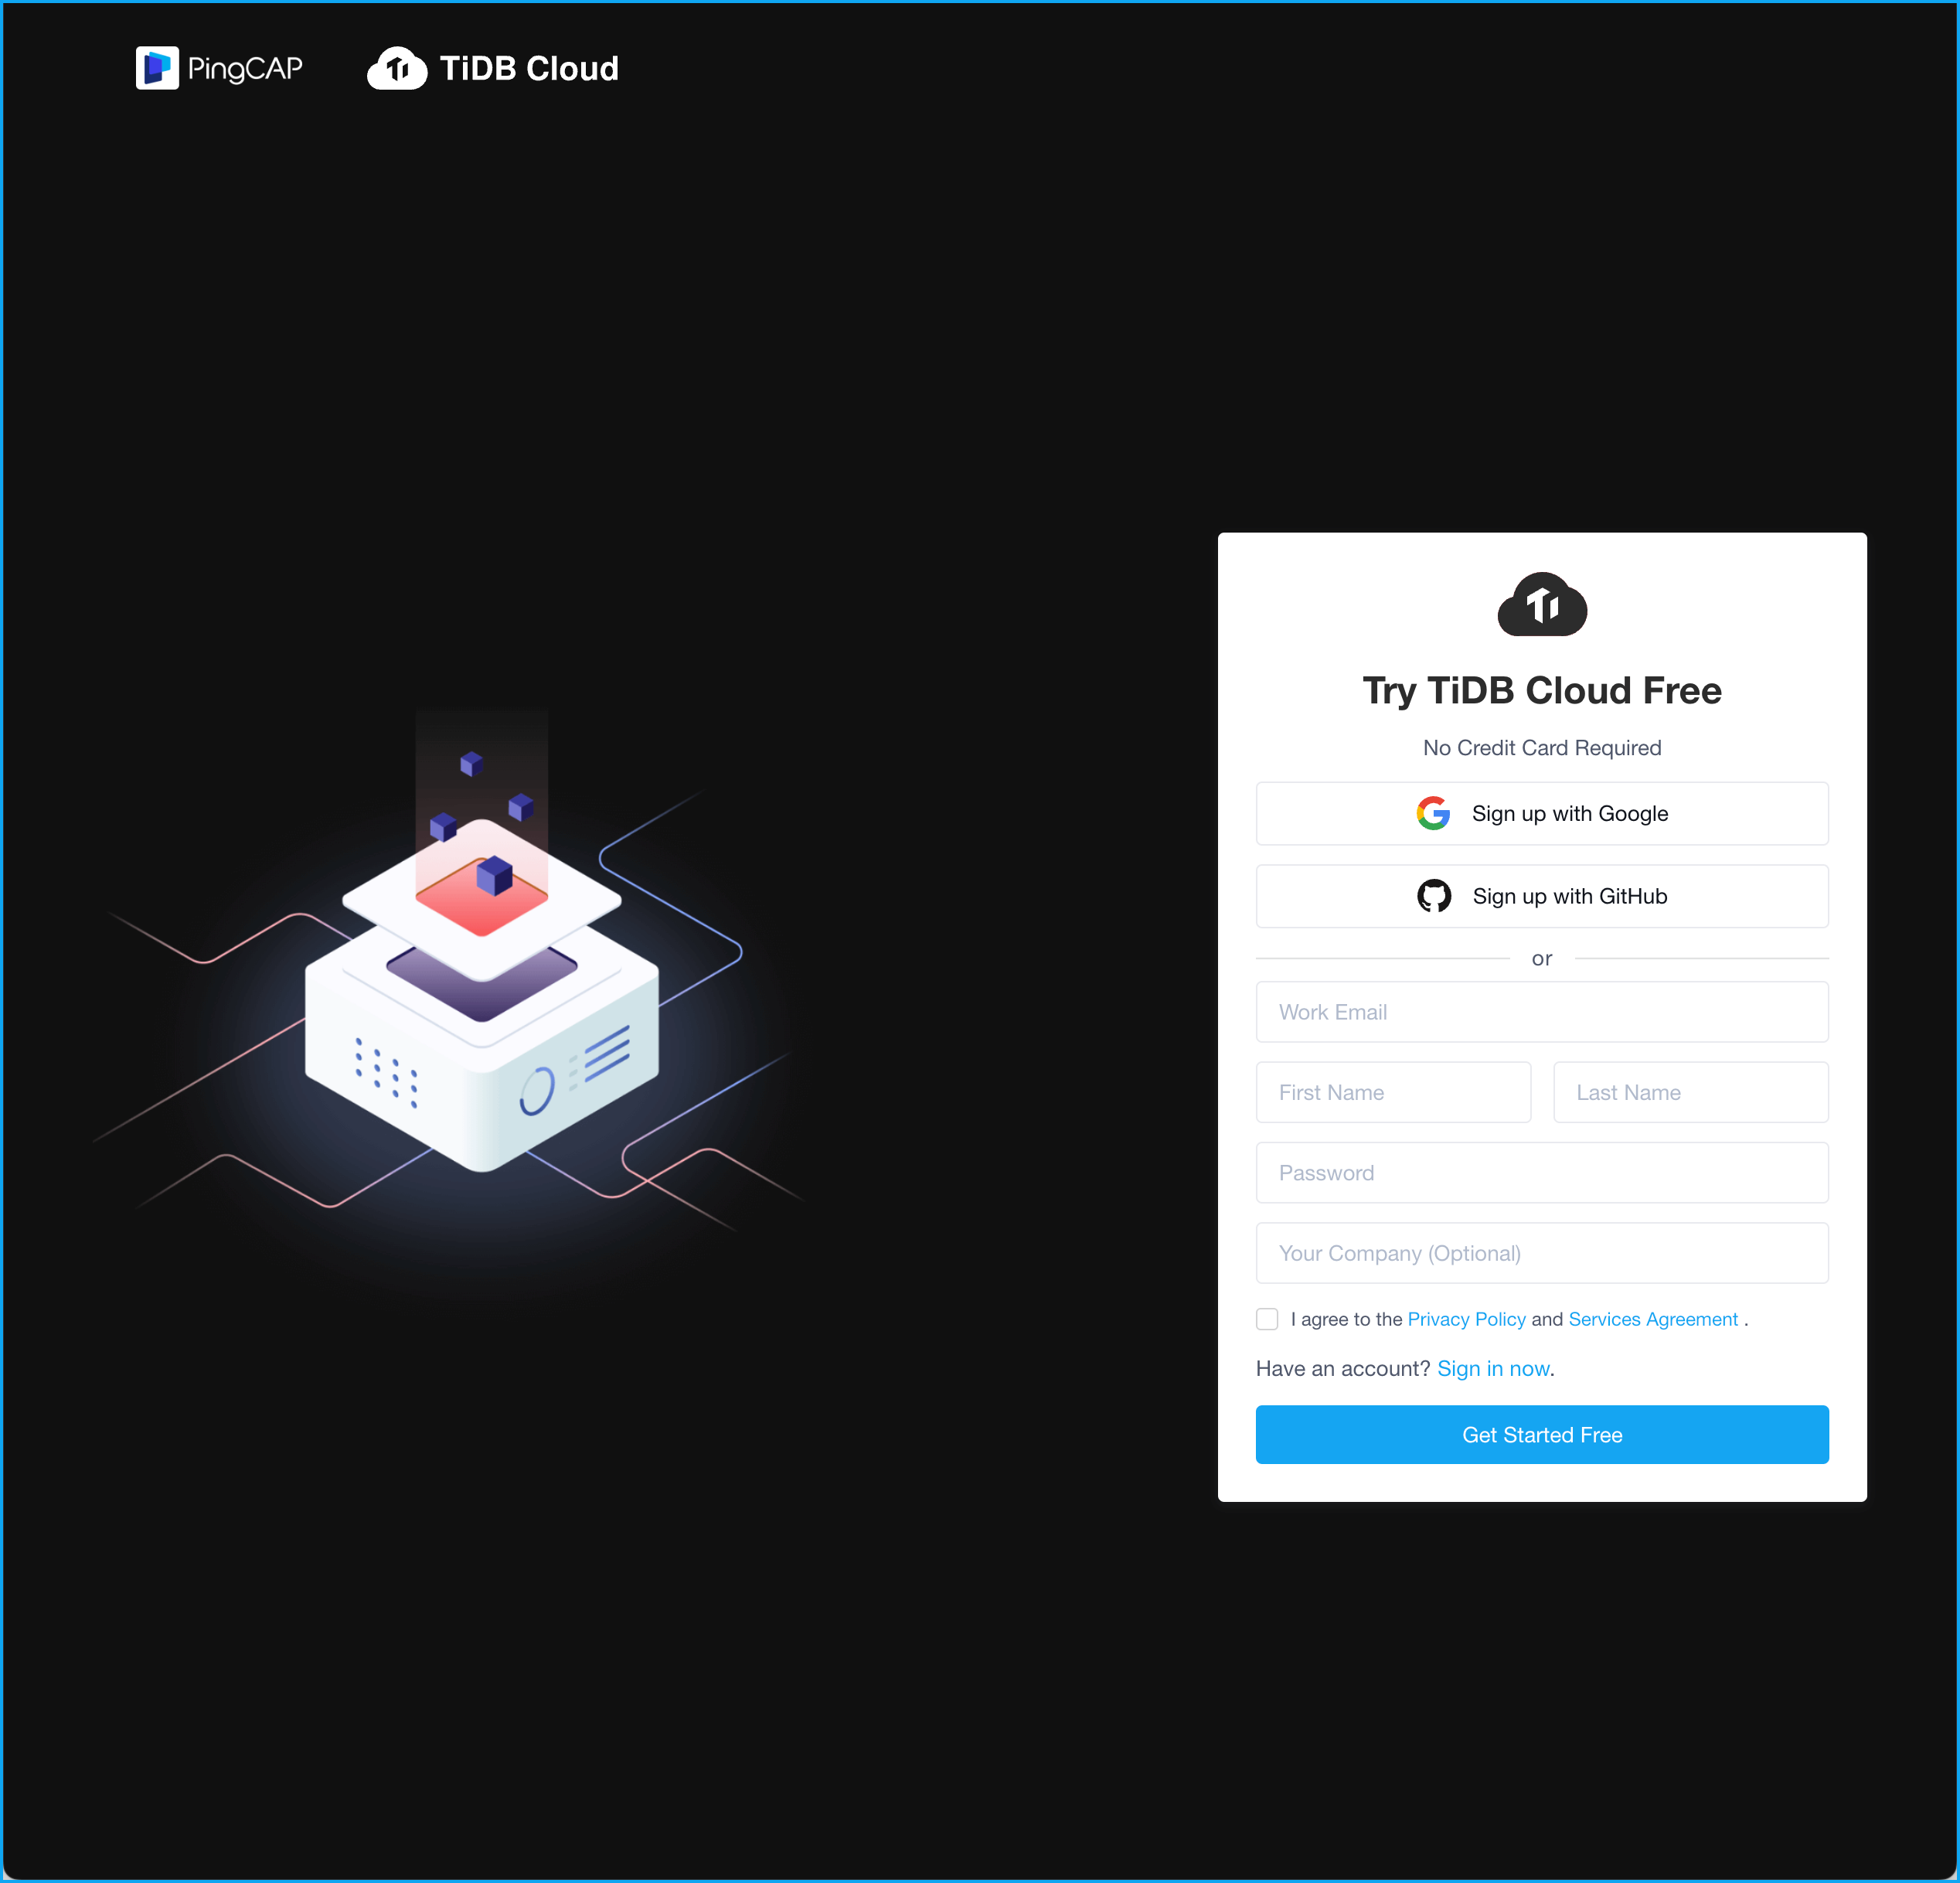
Create your FREE TIDB Cloud Account
Add your info.
Remember your password
Agree to the privacy policy.
Click “Get Started Free”
Notes:
Point out, that you don’t need to enter a credit card to get the account. Sweet!

Slide 7
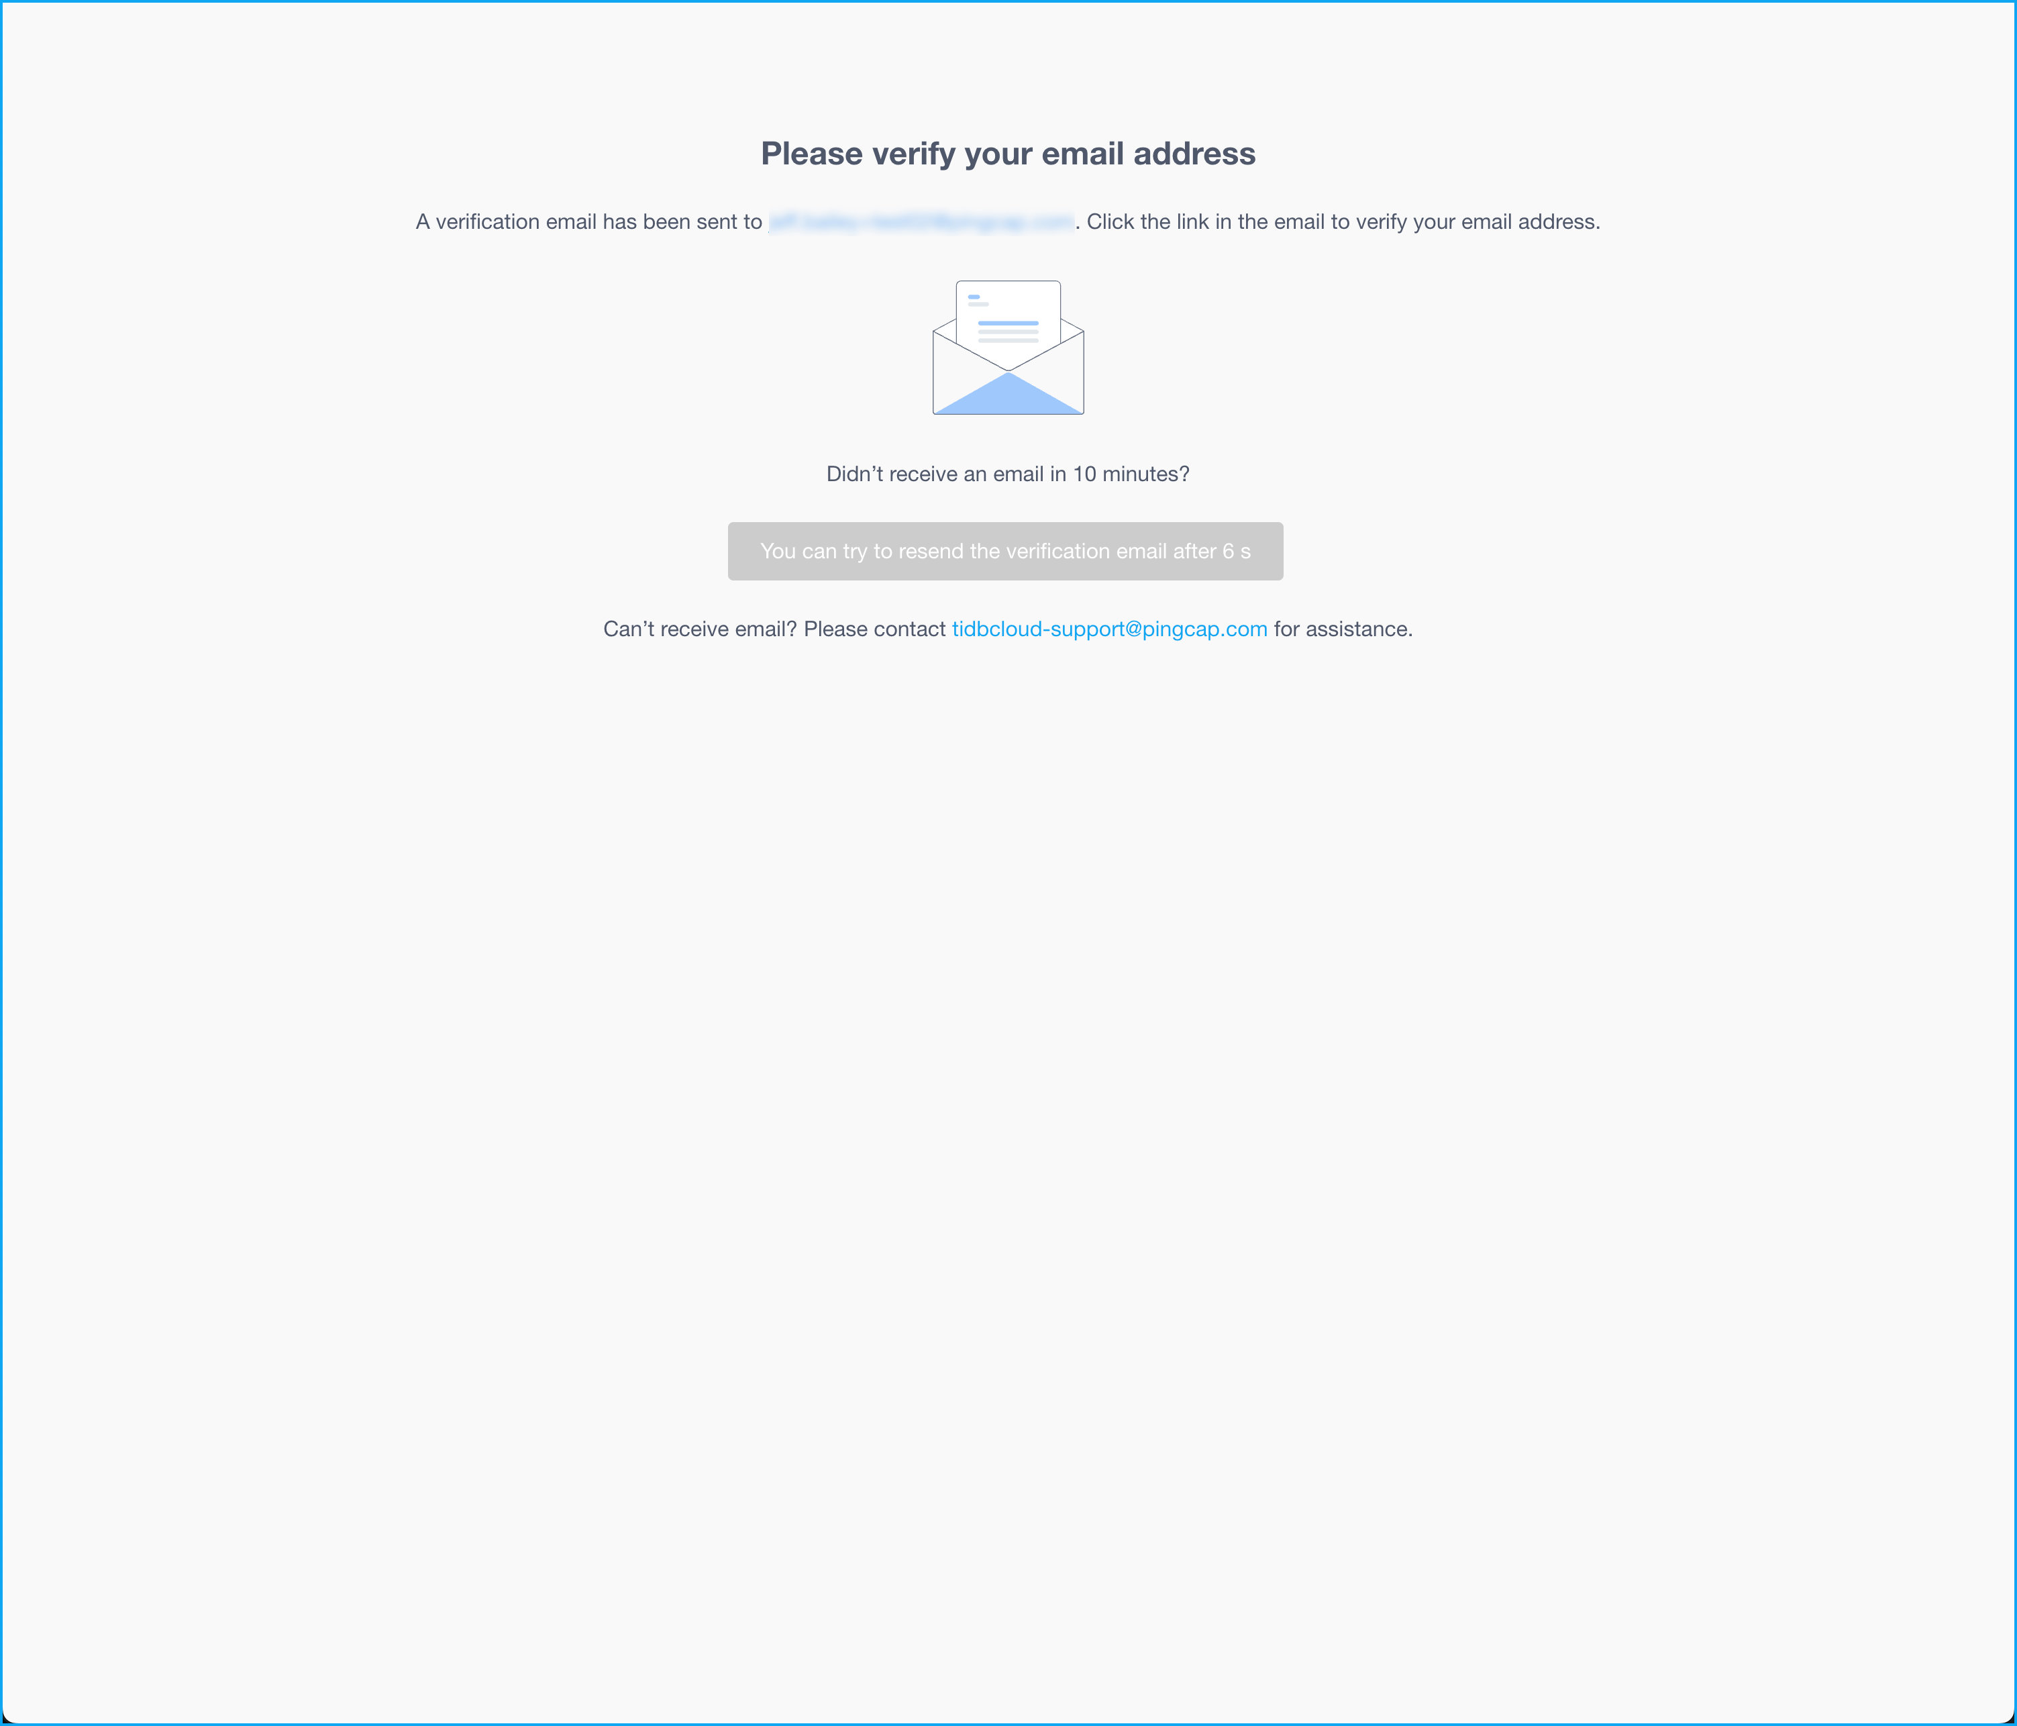
Create your FREE TIDB Cloud Account
Go to your e-mail and verify your FREE account
Click the link in the email
Then log in to your new account!
Notes:
Once you see this screen, you need to go to your email and verify your account.

Slide 8
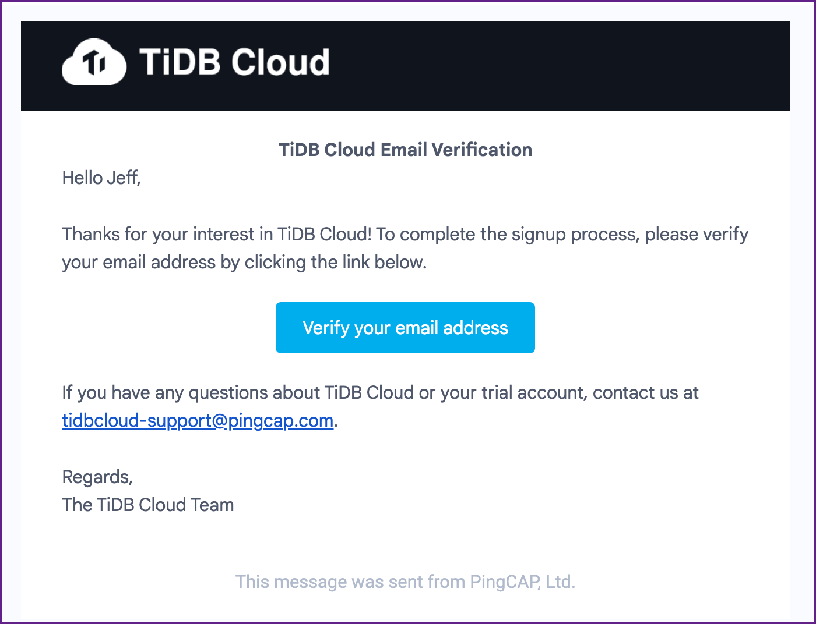
Verify your FREE TIDB Cloud Account
Click Here
Notes:
Open the email from TiDB Cloud and verify your account. The e-mail will have the subject – “TiDB Cloud Email Verification.”

Slide 9
Create a TiDB Cloud Cluster
Notes:
We have an account! it is now time to create a cluster.

Slide 10
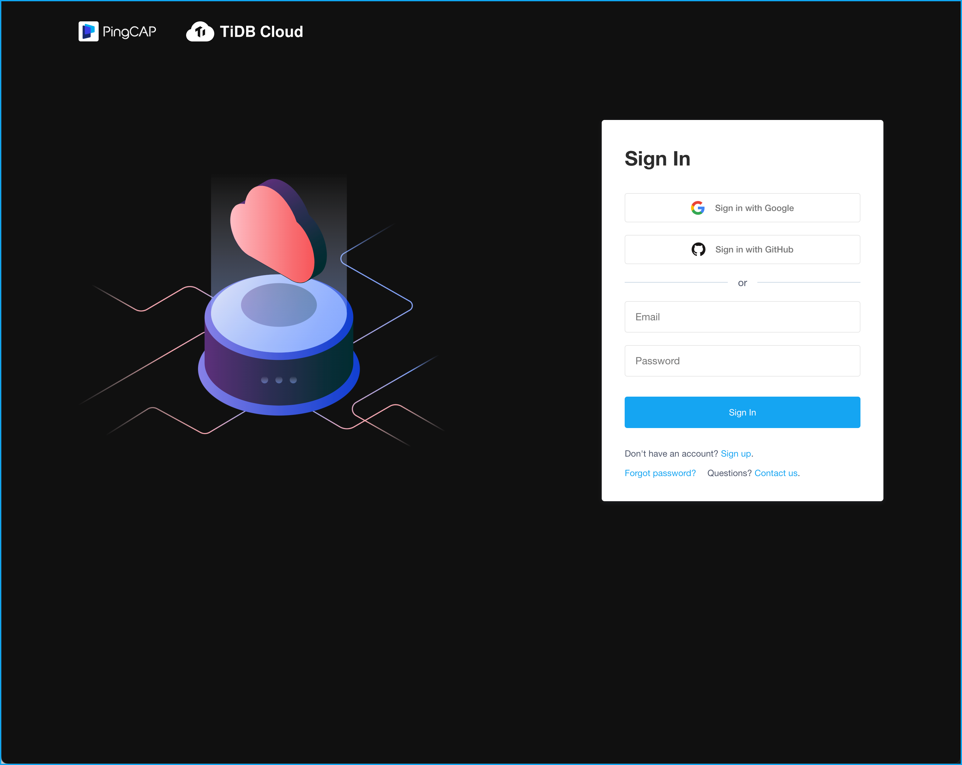
Sign In to TiDB Cloud
Log in to your
TiDB Cloud Account
Go to tidbcloud.com
Notes:
First, we need to log in to our TiDB account.

Slide 11
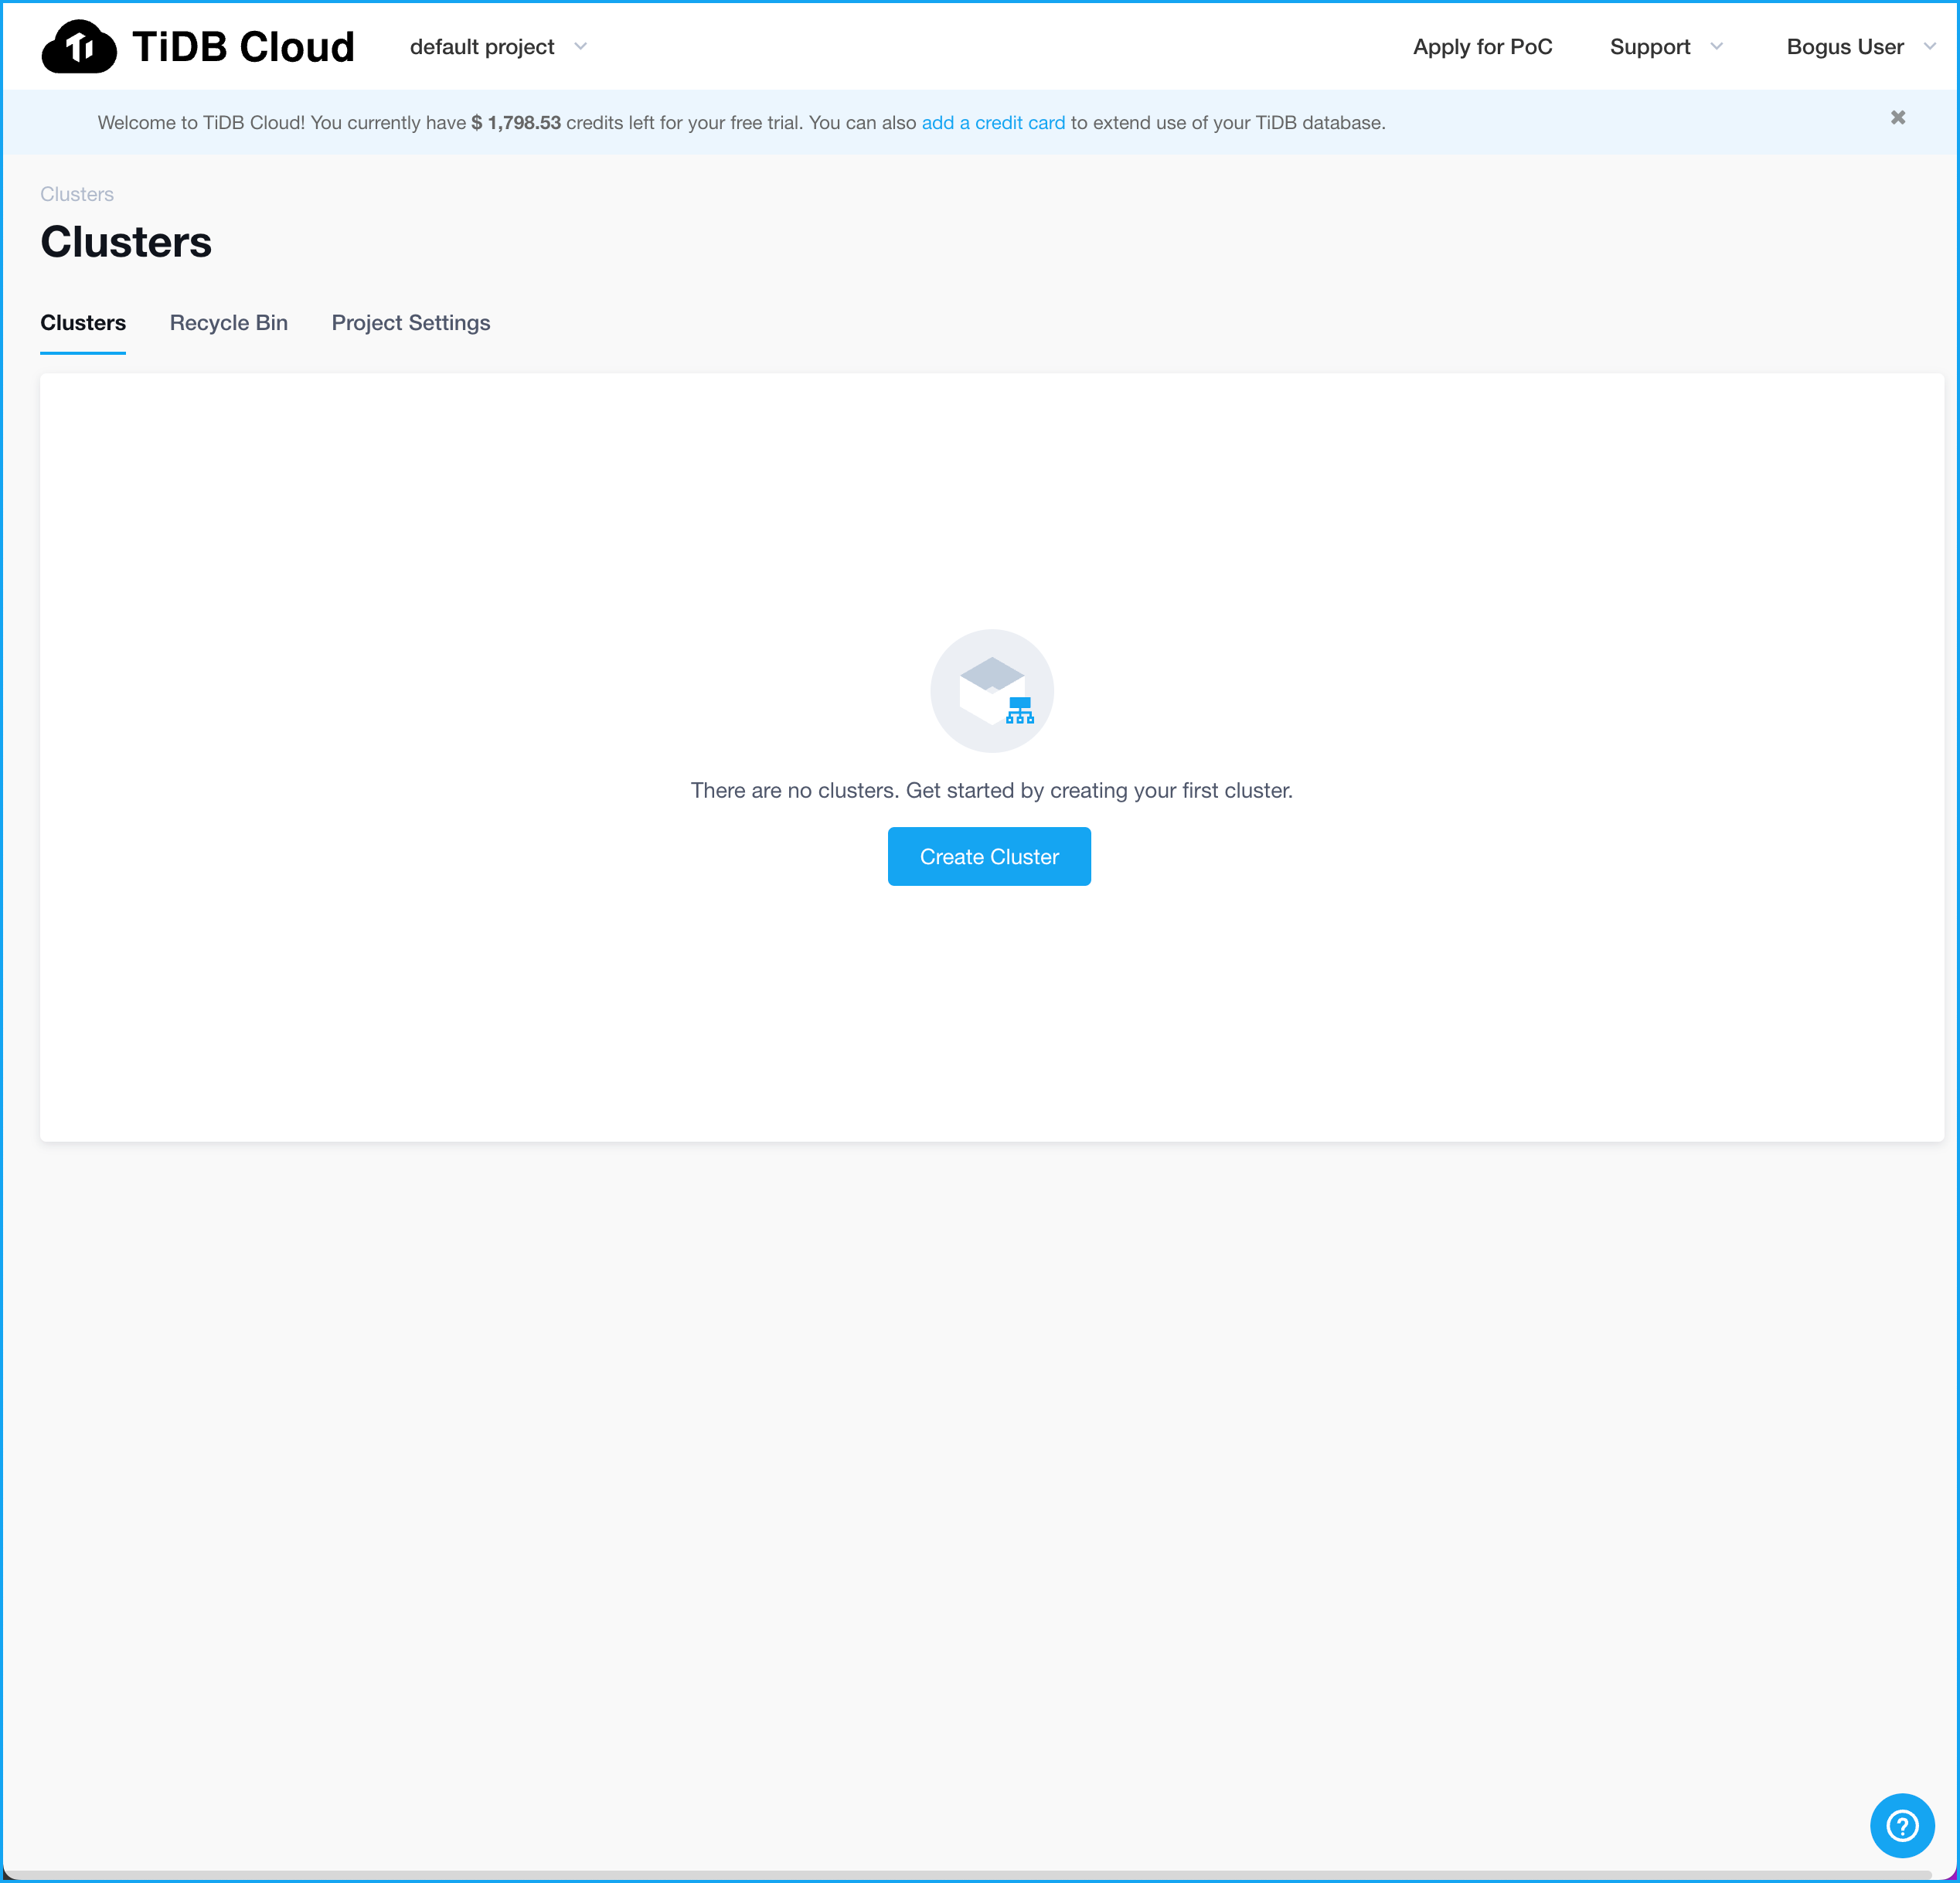
Create a Cluster
Click the
Create Cluster
Button
Notes:
Notice, we have no clusters. We do have a blue button in the middle of the page. Go ahead and click it.

Slide 12
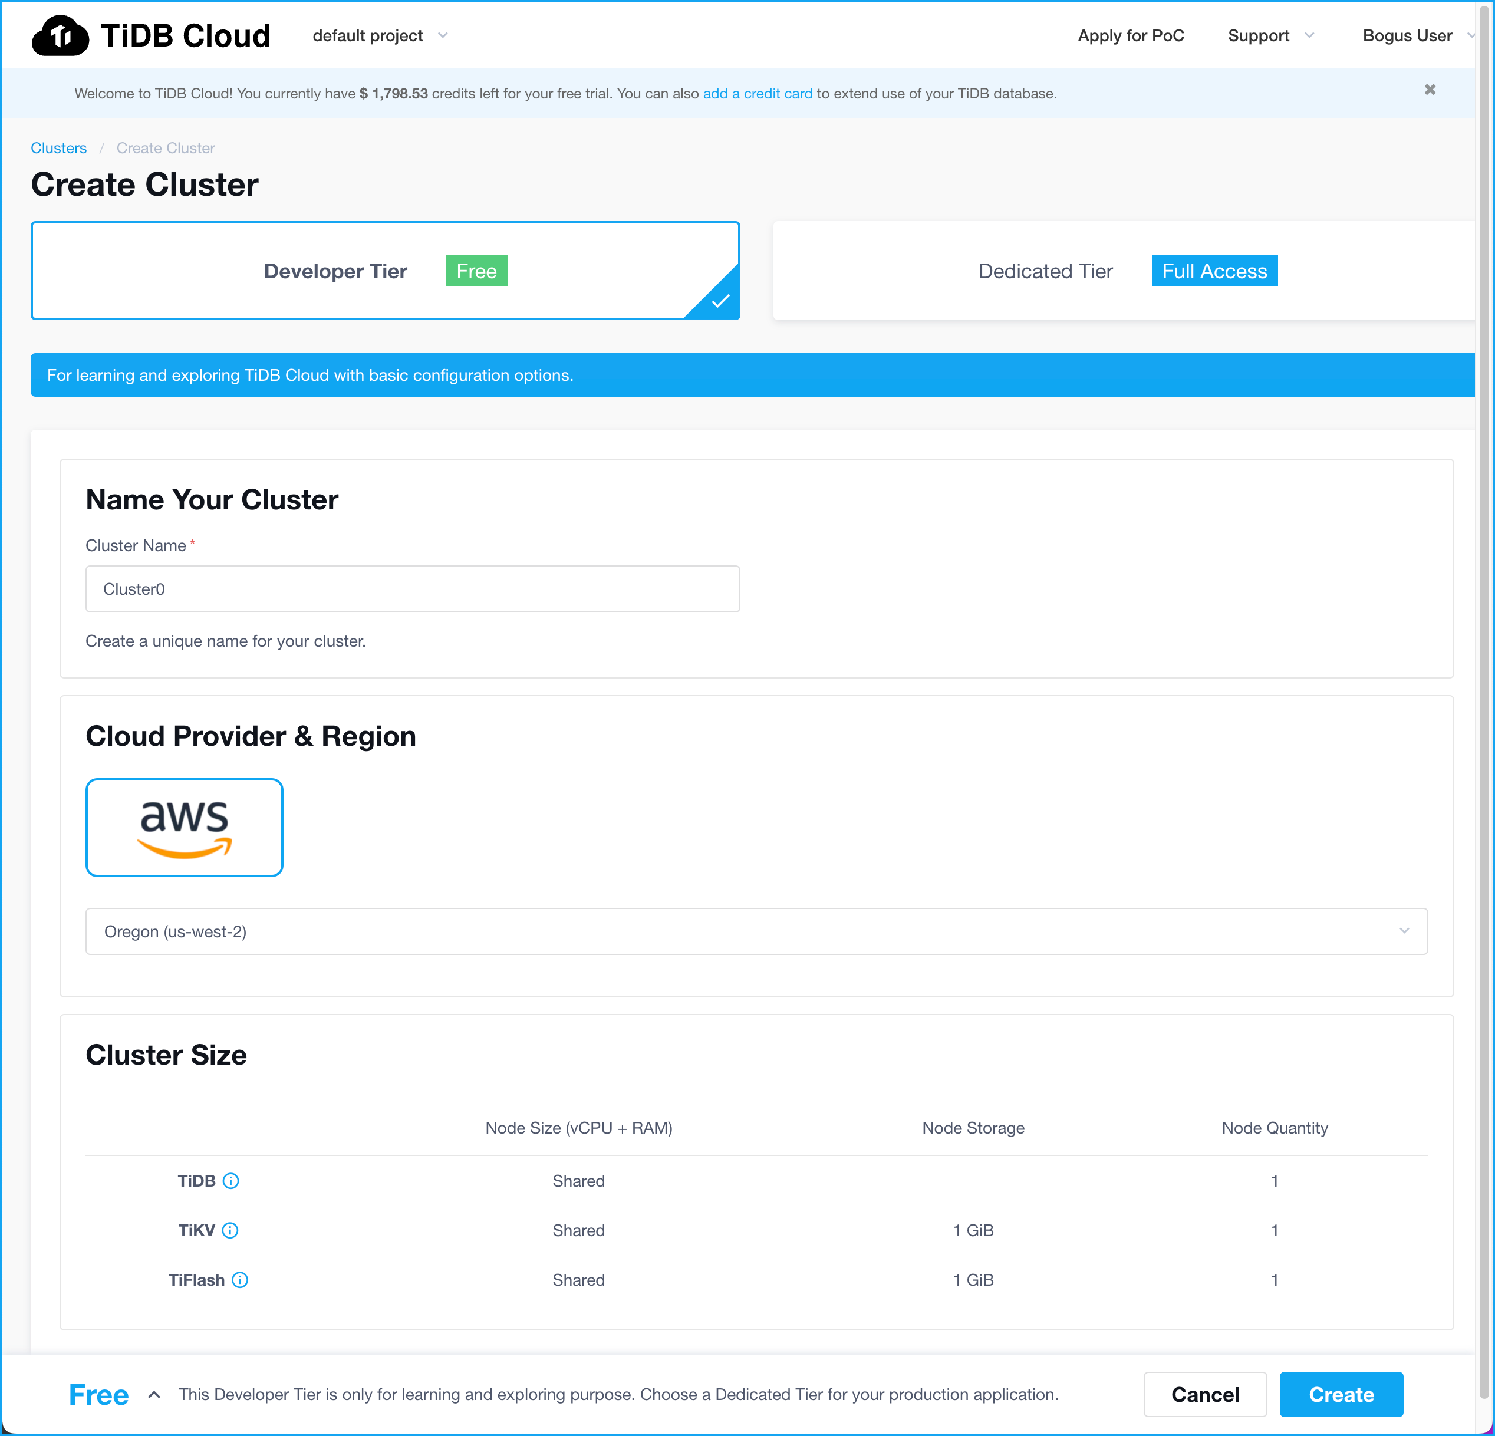
Create a Cluster
Select Developer Tier
Notes:
Make sure that Developer Tier is selected. It is free. In order to create a Dedicated Tier cluster you must have credits.

Slide 13
Create a Cluster
Select Developer Tier
Choose a name for your TiDB cluster
Notes:
Next, we need to name our cluster. In this exercise let’s leave it as Cluster0.

Slide 14
Create a Cluster
Select Developer Tier
Choose a name for your TiDB cluster
Dev Tier runs on AWS
Notes:
The Dev Tier only runs on AWS. So, there is nothing to do here.

Slide 15
Create a Cluster
Select Developer Tier
Choose a name for your TiDB cluster
Dev Tier runs on AWS
Select
us-west-2 for the region
Notes:
Next, we must decide where we want our cluster to run. Feel free to activate the pull-down to see your options. Select us-west-2 because we are in the West US. If you run this again, choose a region near your location.

Slide 16
Create a Cluster
Select Developer Tier
Choose a name for your TiDB cluster
Dev Tier runs on AWS
You can’t change Cluster Size
in the Dev Tier
Select
us-west-2 for the region
Notes:
Finally, take a look at cluster size. There is nothing to do here because we can’t change the cluster size in the Dev Tier. OK, let’s (next slide)

Slide 17
Create a Cluster
Select Developer Tier
Choose a name for your TiDB cluster
Dev Tier runs on AWS
You can’t change Cluster Size
in the Dev Tier
Select
us-west-2 for the region
Click the Create button
Notes:
Click the Create button to create our cluster.

Slide 18
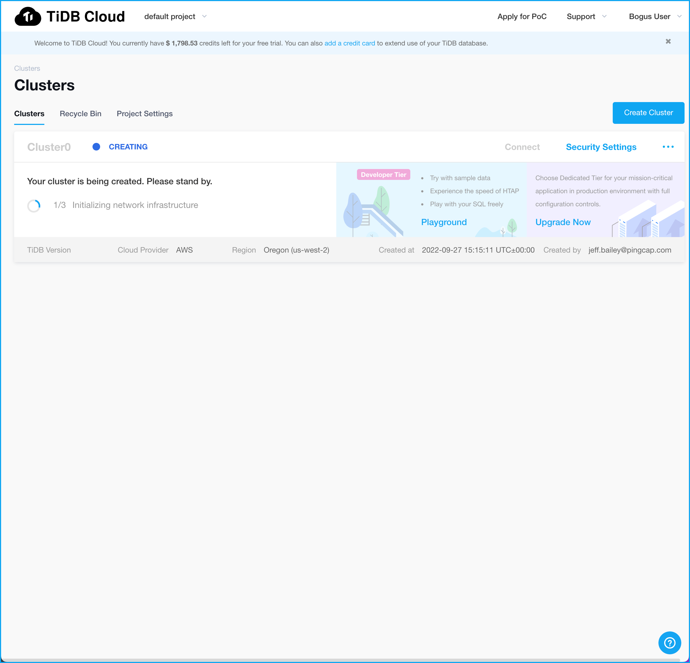
Create a Cluster
Status displays here
This process takes anywhere from 3 to 5 minutes

Slide 19
TiDB Architecture in Five Minutes!
Notes:
It is going to take a few minutes for our cluster to come up. Let’s spend some quality time discussing TiDB Architecture.

Slide 20
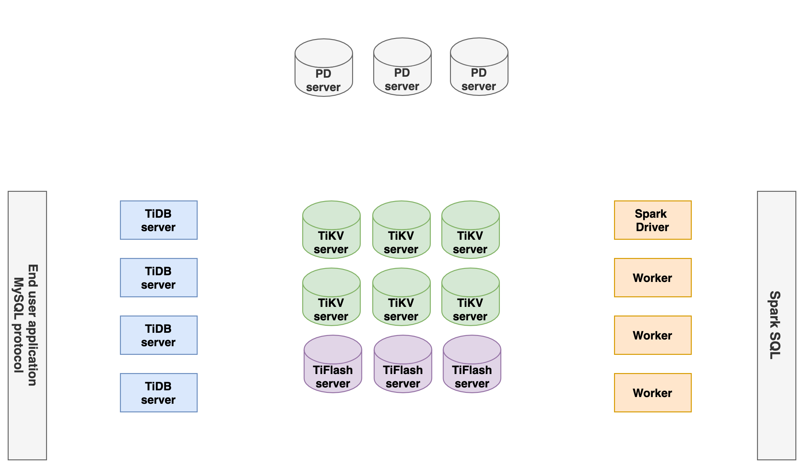
TiDB Architecture
Notes:
This is the TiDB logical architecture. It represents both on-prem and cloud with one exception which we will discuss shortly. The TiDB Cloud environment is much more complicated because of the AWS (or Google Cloud Platform) automation components. We aren’t going to cover this during our workshop because we could spend all our time on it. Just understand that there are components like Kubernetes making all these work.
So, lets discuss our diagram. When you use TiDB or any other database, everything begins with a connection. (next slide)

Slide 21
TiDB User Connections and MySQL Protocol
User Connections
MySQL Protocol
Notes:
TiDB is MySQL compatible. This means that user connections use the MySQL protocol. Our diagram shows our End user application (in the red box). The arrows imply a connection to… (next slide)

Slide 22
TiDB Server Handles Connections and Runs SQL
TiDB Server
Clients connect here
SQL Processing
Notes:
a TiDB Server. This is the SQL layer. What does this mean, exactly?
Well, it means that TiDB server accepts connections from the MySQL client. It parses SQL statements. Creates the SQL execution plans. And orchestrates the execution of the query. TiDB is distributed so TiDB server is responsible for collecting the resultant data and producing query output. But, and this is cool, the storage layer (next slide)

Slide 23
Storage Cluster: TiKV Handles Relational Data (Row-Based)
Storage cluster
TiKV handles the Transactional side
TiFlash handles the OLAP side
Notes:
can do some processing, too. Think of this as SQL push-down. Some SQL processing is pushed into the storage layer. In this example, we are talking about TiKV.
Remember, TiDB is a Hybrid Transactional/Analytical Processing (HTAP) database. TiKV handles the transactional side of the HTAP equation. This is also called on-line transaction processing. TiKV stores the data in rows. TiKV is mandatory for your TiDB cloud environment.
Row-based is only the beginning.

Slide 24
Storage Cluster: TiFlash Handles OLAP Data (Columnar)
Storage cluster
TiKV handles the Transactional side
TiFlash handles the OLAP side
Notes:
TiFlash in our second storage engine. TiFlash is a columnar store. Columnar stores are perfect for analytic-type queries. TiFlash is optional. You don’t have to included it in your TiDB environment.
You are probably asking yourself, “How do I tell TiDB to use TiFlash instead of TiKV?” That’s a great question. Stay tuned, we will cover this in a few minutes. The answer will surprise you?
Every database needs a brain. Let’s discuss the brains of TiDB…

Slide 25
Placement Driver: The Brains of TiDB
Placement Driver
The Brains of the operation.
Notes:
The Placement Driver keeps track of data and information that TiDB needs to run. Like we said, the PD is the brains of TiDB. We won’t get into a lot of specific details, but I need to point out that the PD is responsible for timestamps. The TSO on the upper right hand side of the diagram stands for Time Stamp Oracle. TSO is responsible for time stamps.
Well, there is one subsystem remaining on our diagram. (next slide)

Slide 26
Spark Driver
Spark Driver
Not included in
TiDB Cloud
Notes:
The Spark Driver. You have likely heard of Spark. It is an open source, in-memory analytics engine. It is an optional component in on-prem environments. The Spark Driver is (next slide)

Slide 27
Spark Driver: Not Included In TiDB Cloud
Spark Driver
Not included in
TiDB Cloud
Notes:
not included with TiDB Cloud. So we don’t need to worry about it or pay for it to run. This leaves us with… (next slide)

Slide 28
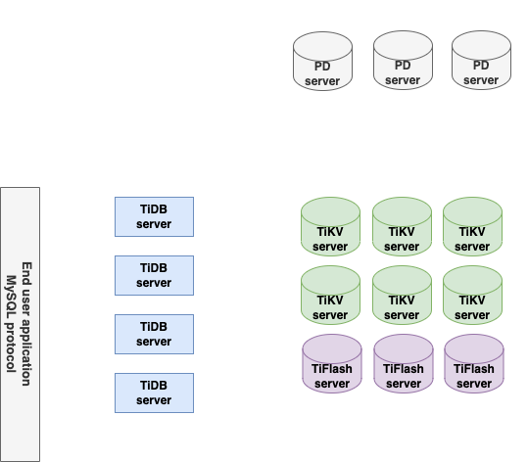
TiDB Cloud Logical Architecture
Notes:
a revised logical diagram. OK, our clusters are probably ready for us to use now. Take a look at your browser.

Slide 29
Configure Your Cluster’s Security Settings
Notes:
Our cluster is up-and-running, but we need to configure some security settings. I think you will be surprised by how easy this is.

Slide 30
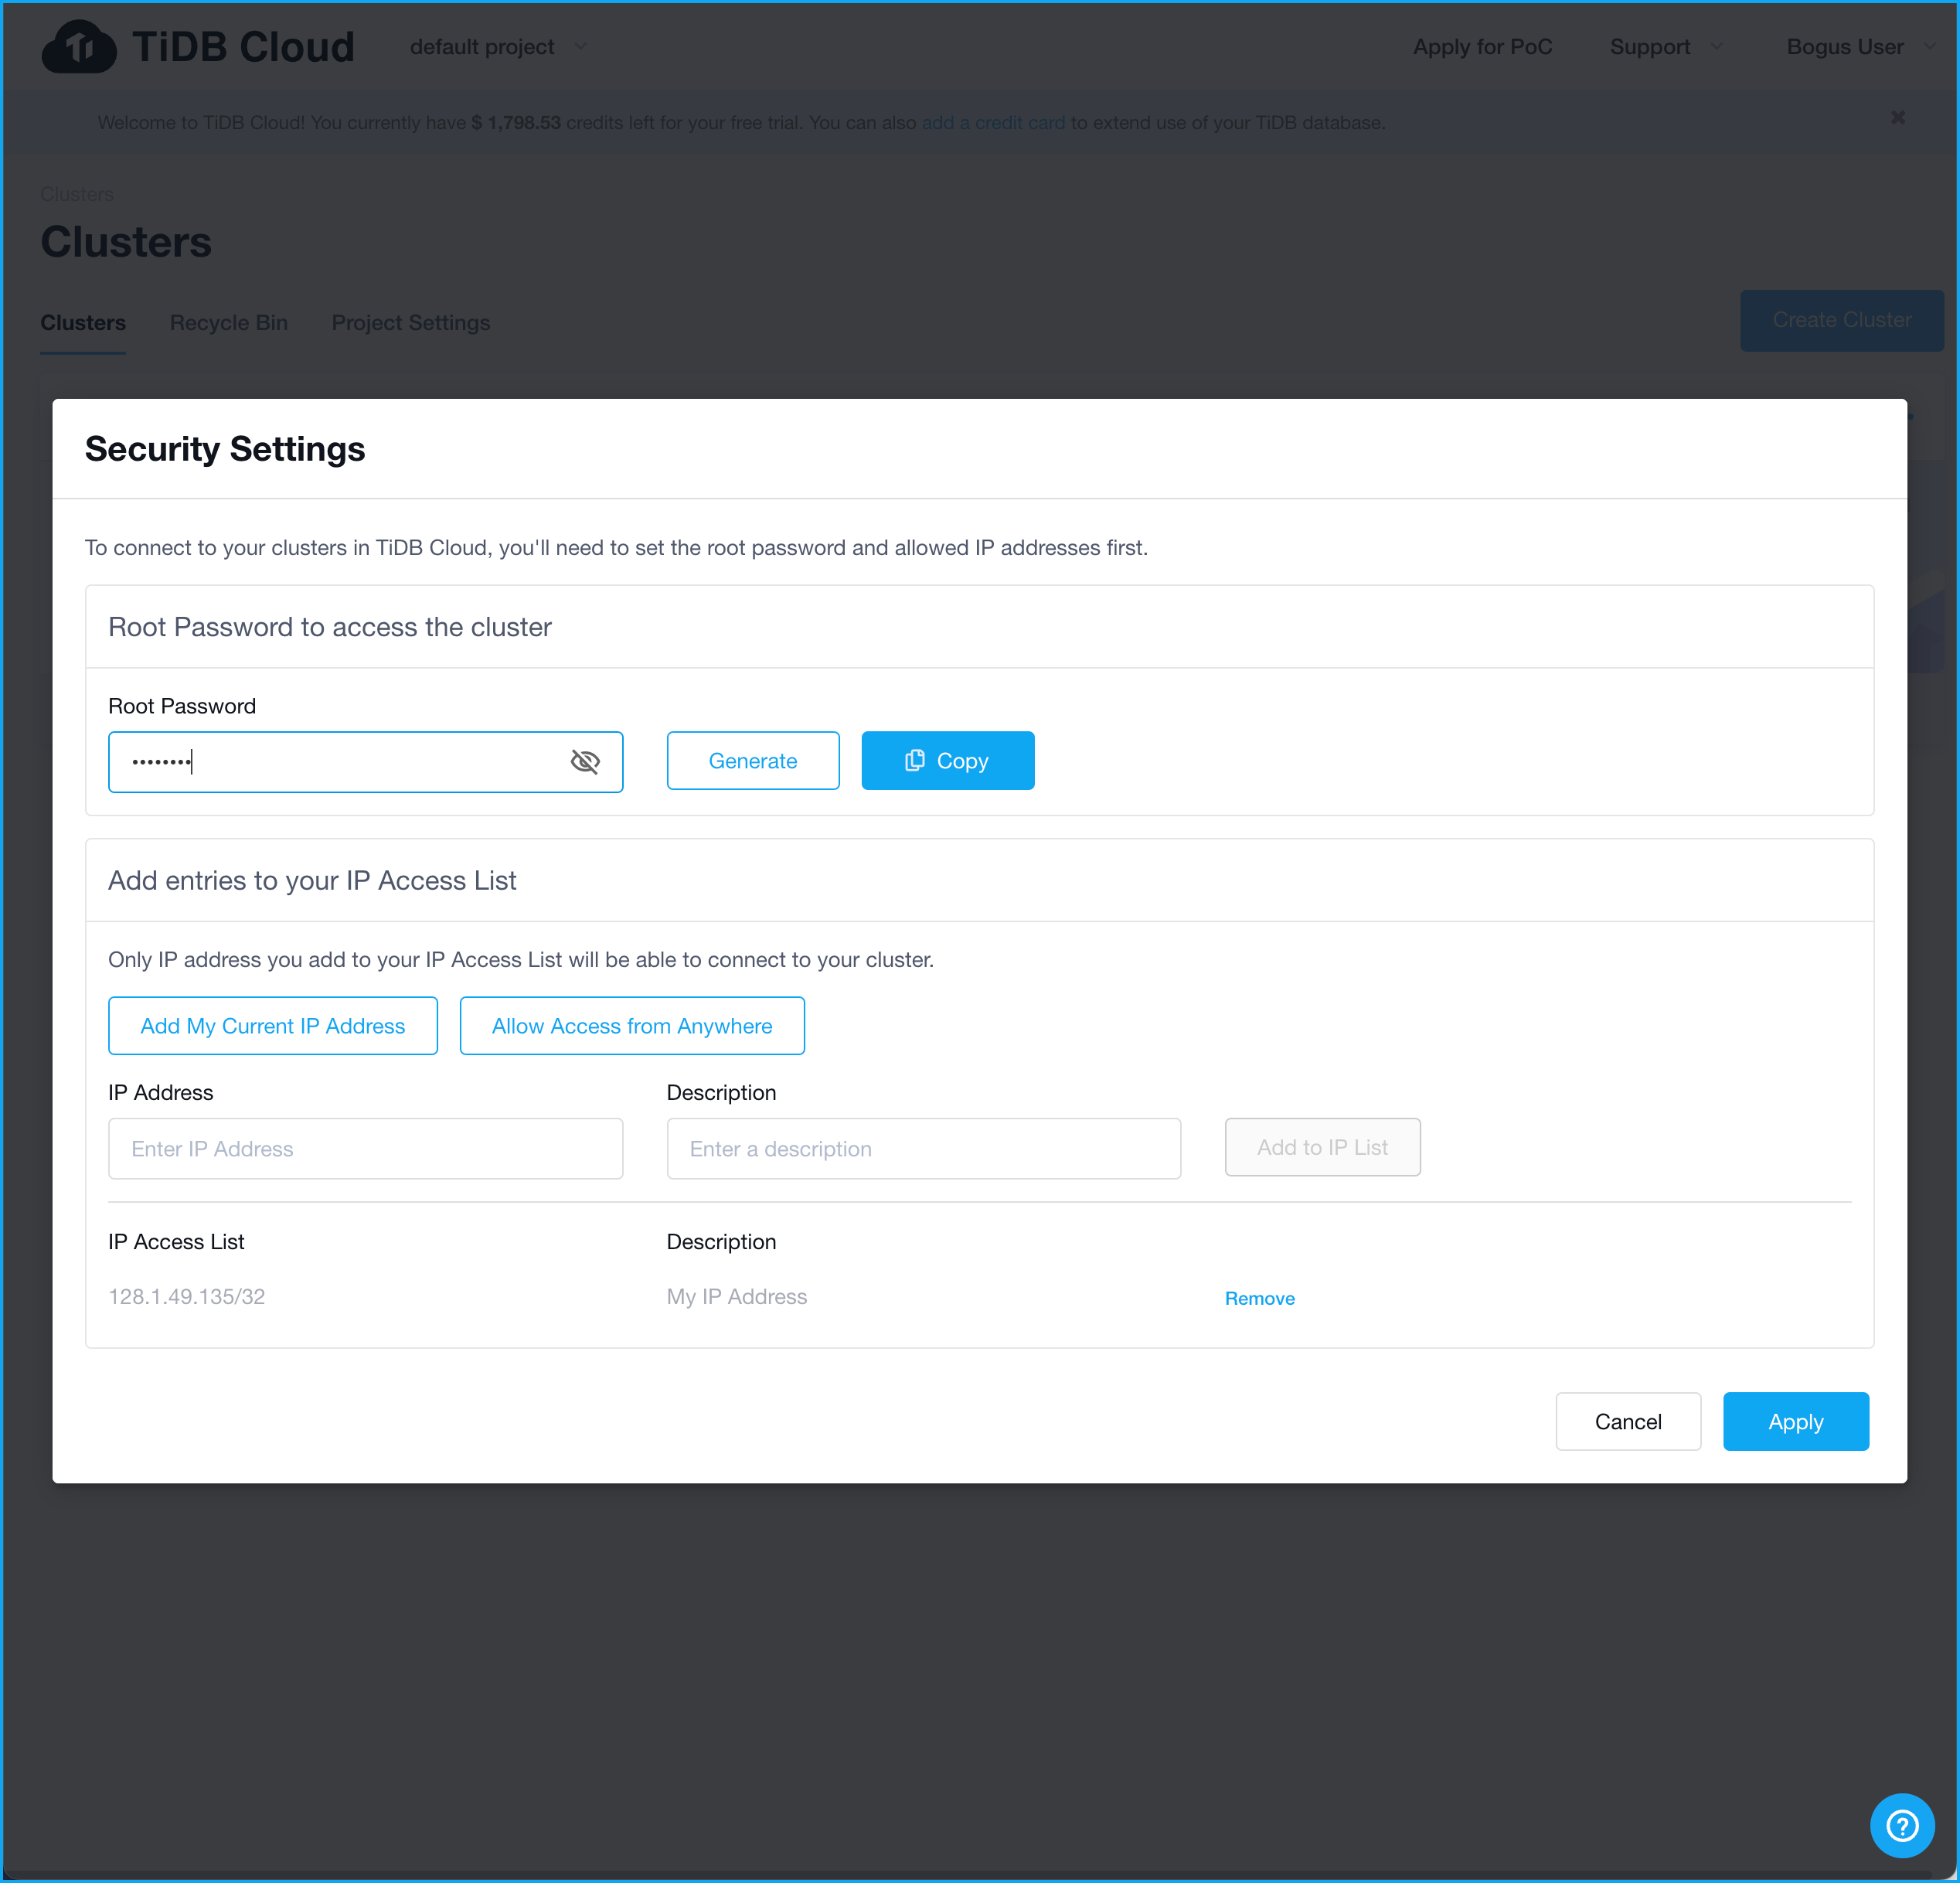
Set the Root Password
Assign a
Root Password
Assign a
Root Password
If you forget your password, you can return to Security Settings and reset it.
Notes:
You can reset your password. Just return to Security Settings and enter a new one.

Slide 31
You IP Address is added for you
Assign a
Root Password
Assign a
Root Password
By Default, the IP Address of your machine is added here
Notes:
Clicking Allow Access from Anywhere will set the CIDR to 0.0.0.0/0. This is not a good idea for a cluster will real data in it.

Slide 32
You can add additional IP Addresses
Assign a
Root Password
Assign a
Root Password
If you need to add more CIDRs, you can do it here.
By Default, the IP Address of your machine is added here
Notes:
You can add more CIDRs here. But we don’t need to do that in this exercise.

Slide 33
Connect to Your Cluster

Slide 34
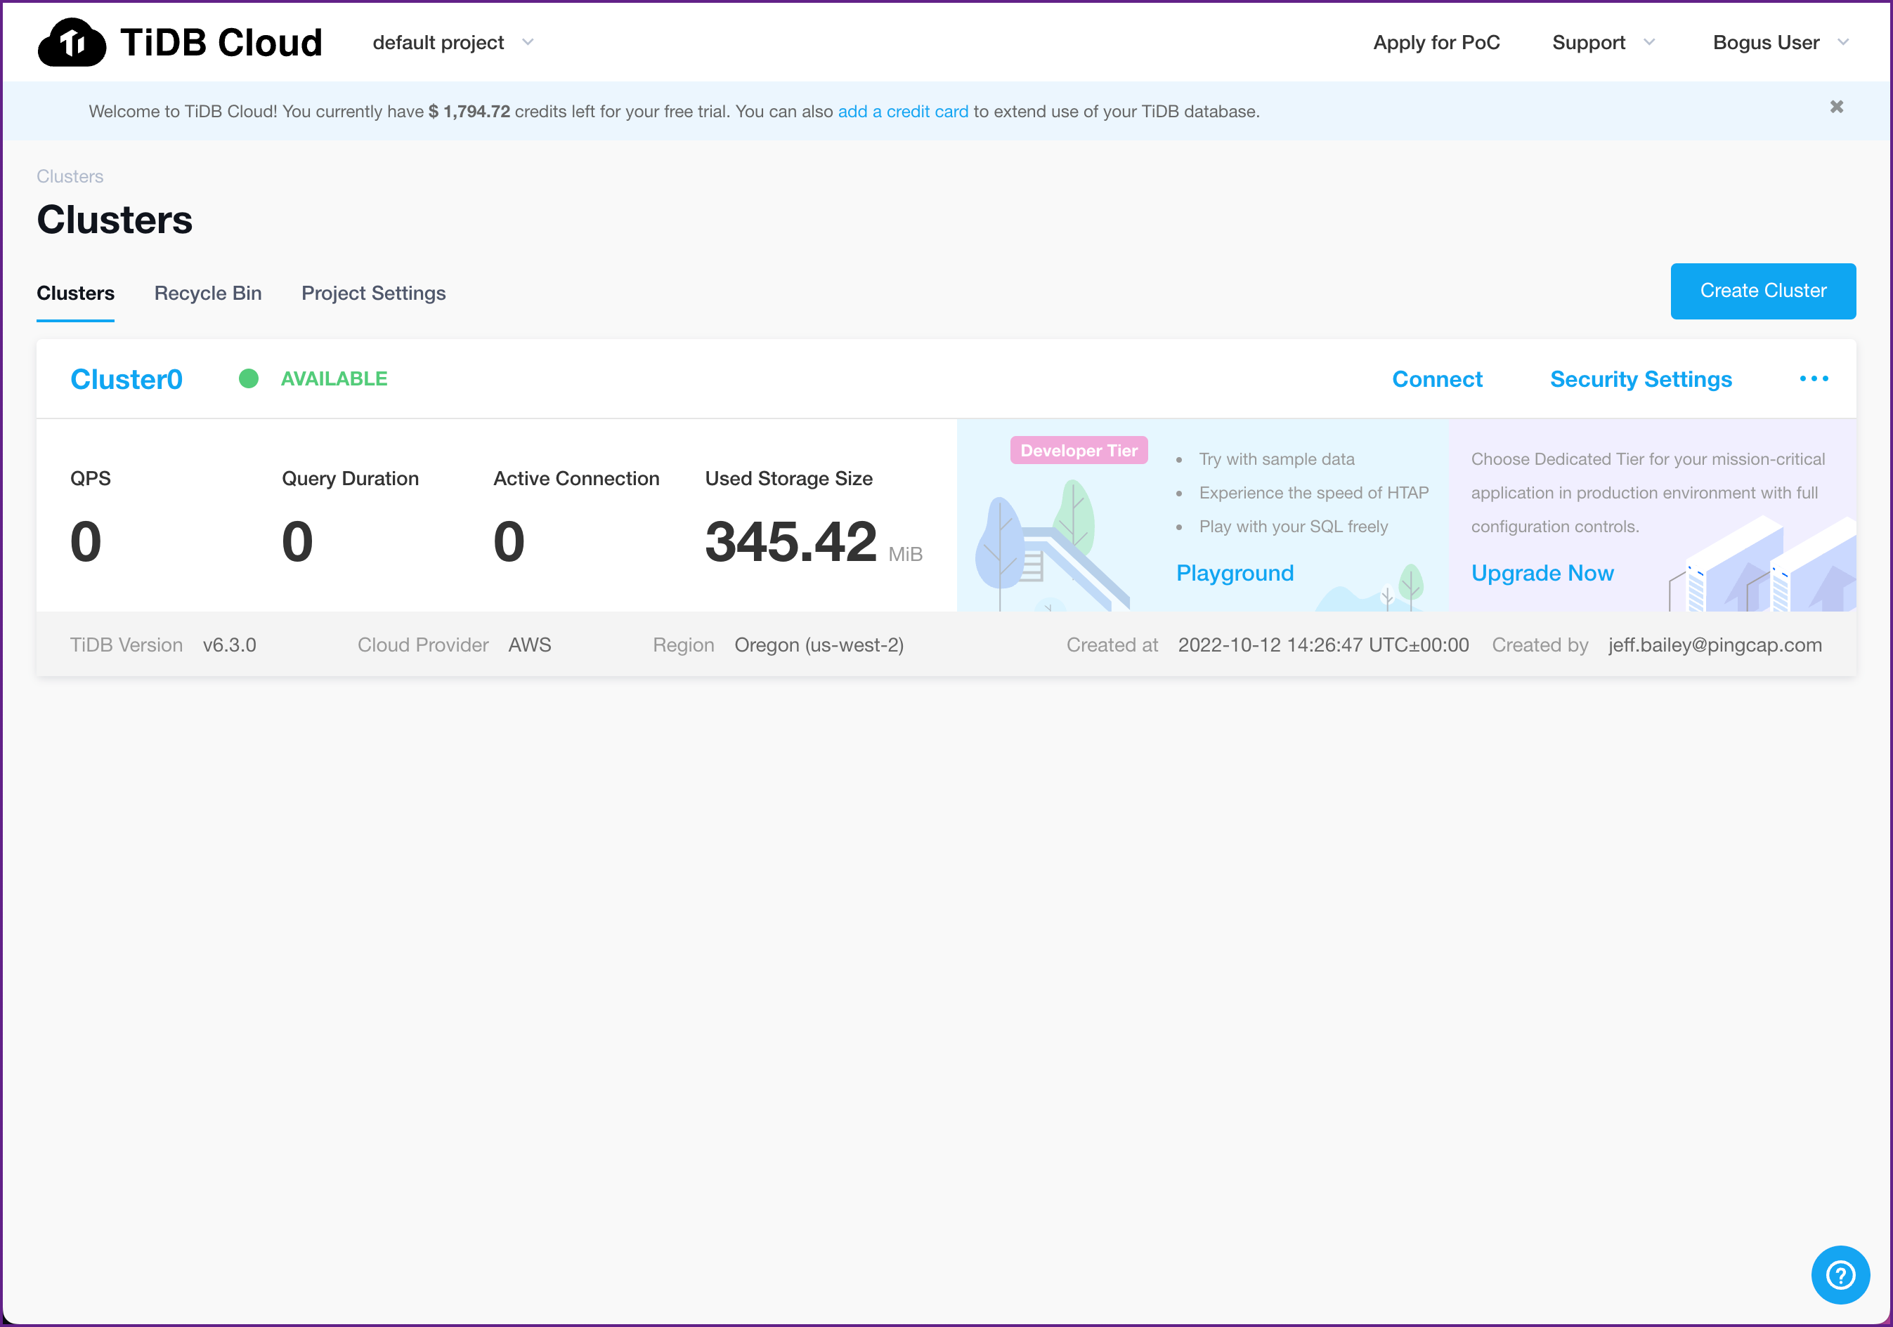
Connecting to TiDB Cloud
Click here
Notes:
The Connect tab is where we go to get information on how to connect to our cluster.

Slide 35
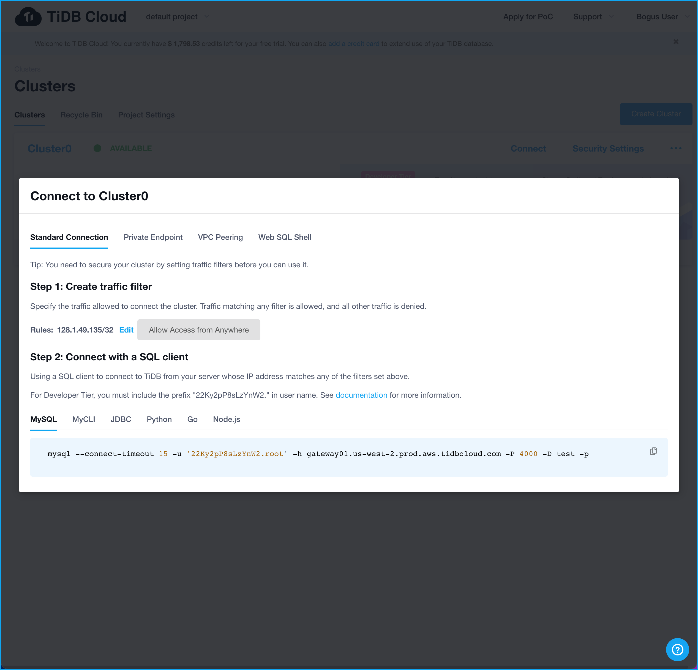
Connecting to TiDB Cloud
If you need to, you can change the Traffic Filter here
Notes:
We saw this under Security Settings too. Keep in mind, you can change your Traffic Filter here, too.

Slide 36
Connecting to TiDB Cloud
If you need to, you can change the Traffic Filter here
The UI provides copy/paste connection examples
Notes:
The UI provides copy/paste connection examples. We won’t need to use these during our workshop, but feel free to take a look at them.

Slide 37
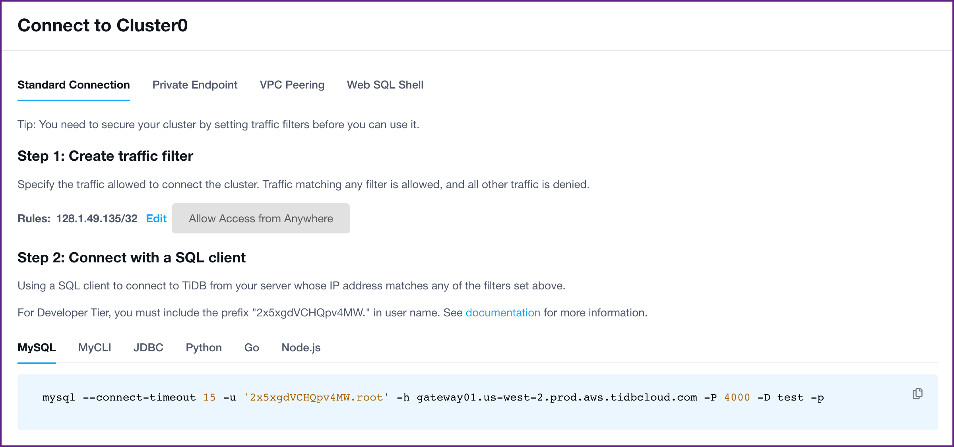
We Can Connect from MySQL Client Applications
Copying the command is easy
Notes:
Copying the command is easy.

Slide 38
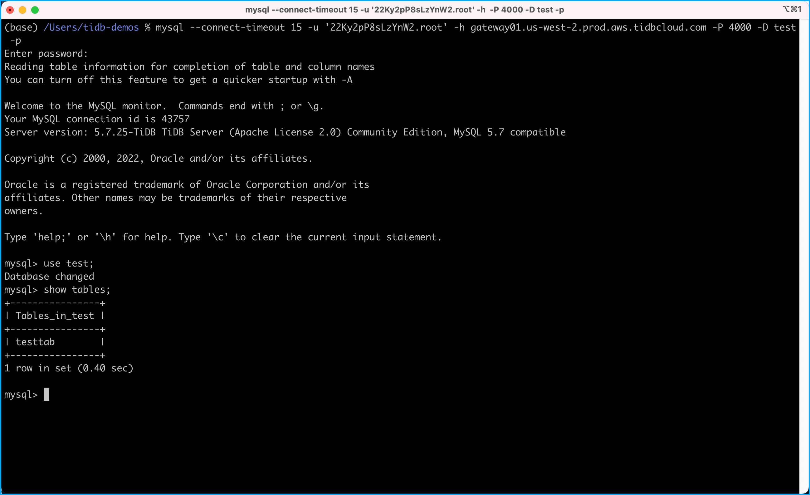
We Can Connect from MySQL Client Applications
Click here to copy the command!
Paste it into a Terminal window!
Notes:
Here is an example of using the copied command to connect to a TiDB Cloud cluster.

Slide 39
Connecting to TiDB Cloud
Click on Web SQL Shell
Notes:
Let’s enter some SQL Queries. Click on Web SQL Shell.

Slide 40
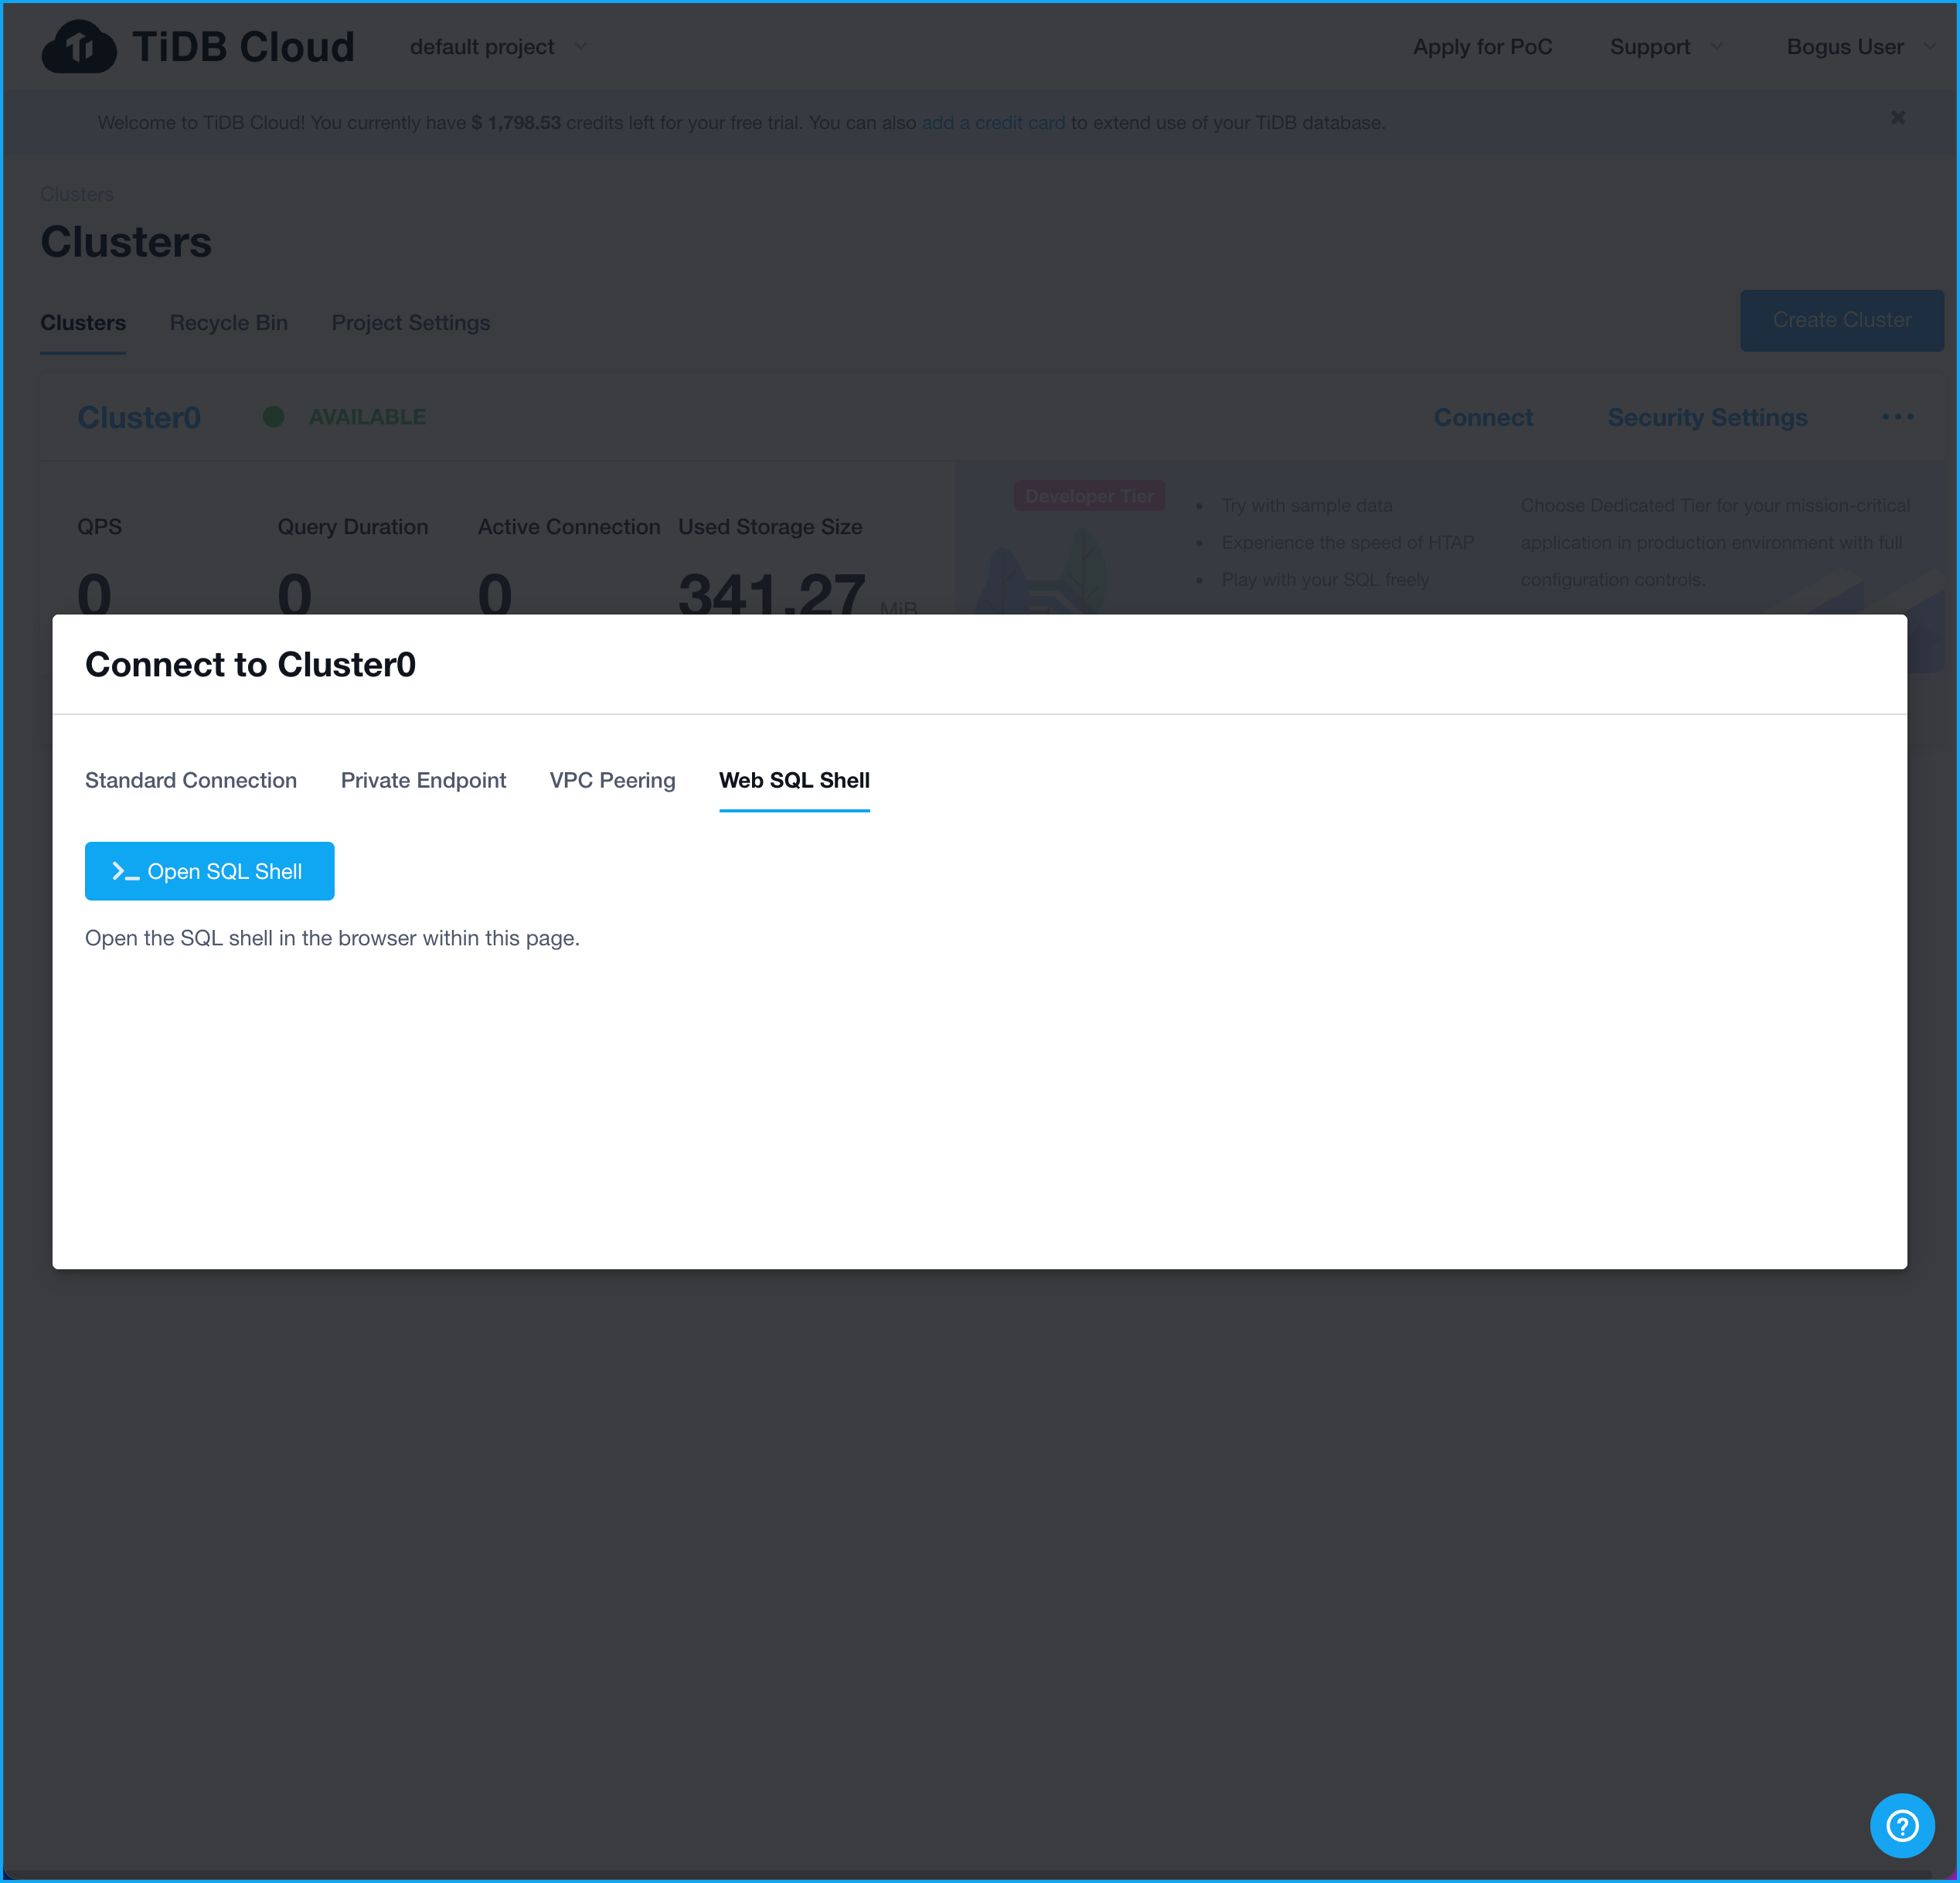
Connecting to TiDB Cloud
Click here
Notes:
We can open the Shell by clicking on Open SQL Shell.

Slide 41
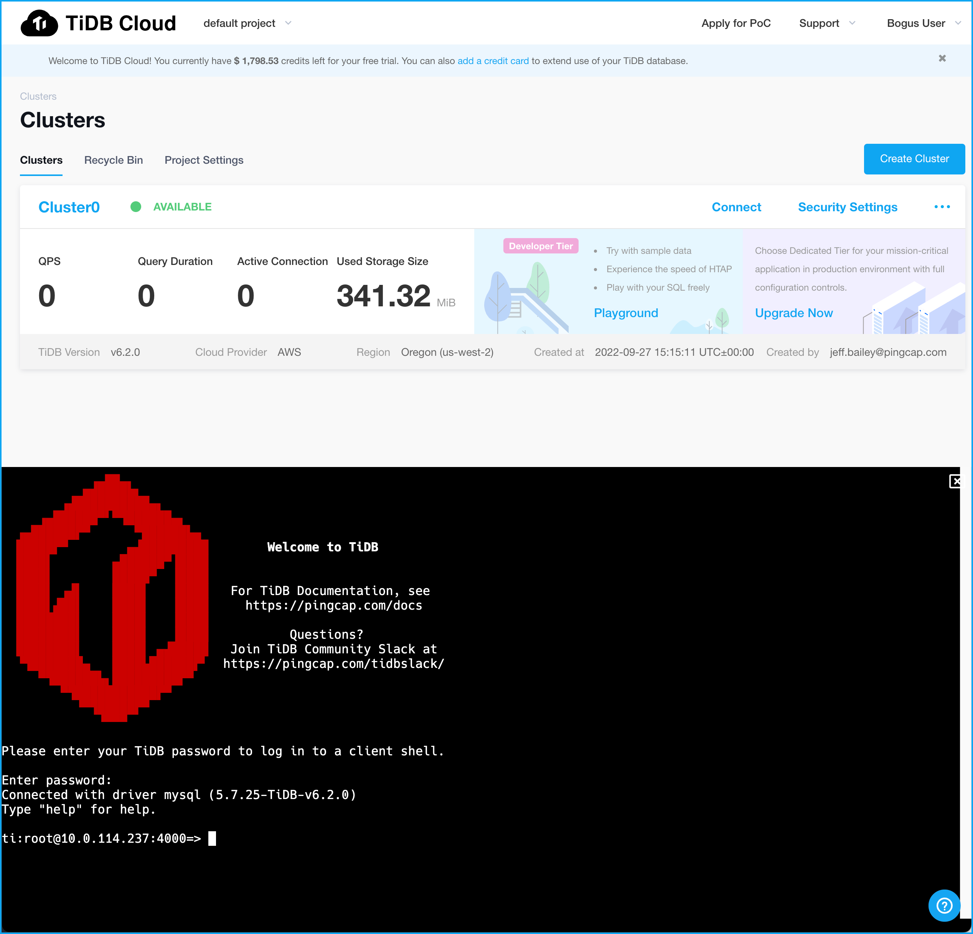
Connecting to TiDB Cloud
Enter Root Password
Notes:
This is the password for the cluster we created and not the password for our TiDB Cloud account.

Slide 42
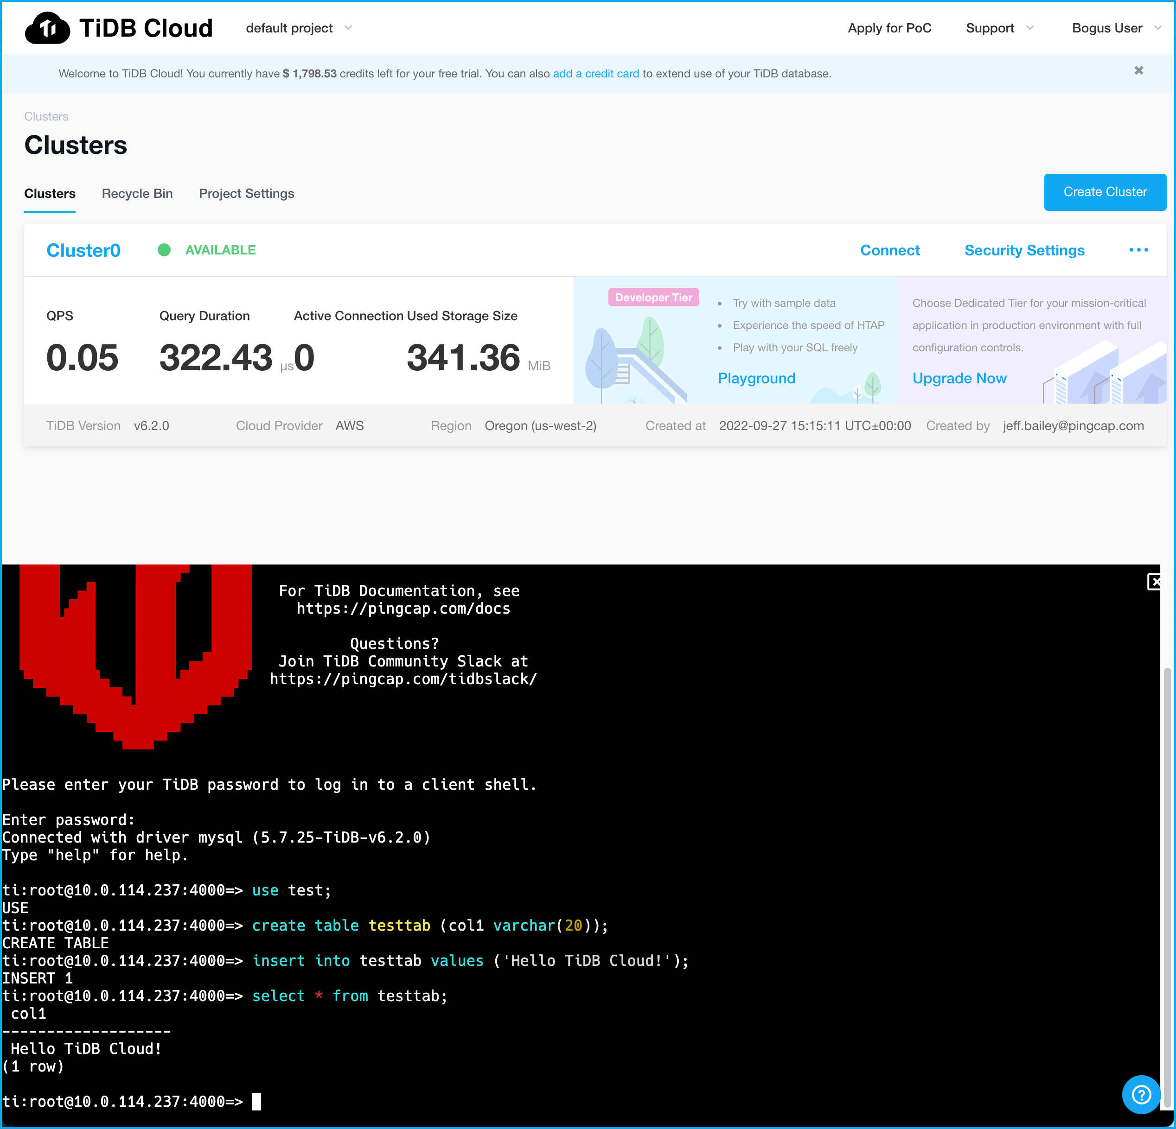
Connecting to TiDB Cloud
Enter these commands:
use test;
create table testtab (col1 varchar(20));
insert into testtab values (‘Hello TiDB Cloud!’);
select * from testtab;
Notes:
Once you get connected, enter the commands in the RED box. Make sure the output matches that shown. If you have any issues, raise your hand and we will help you.

Slide 43
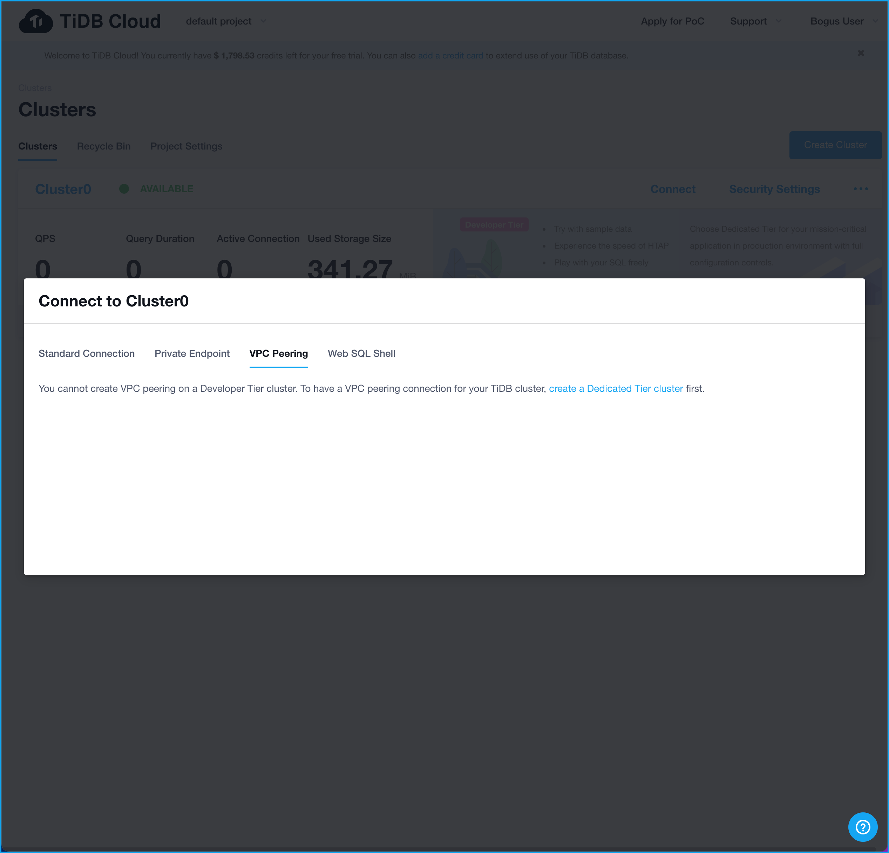
Connecting to TiDB Cloud
Not available in the
Developer Tier
Notes:
Let’s revisit our connection page. We have discussed Standard Connection and Web SQL Shell. Notice Private Endpoint and VPC Peering. They implement custom networking configurations. Implementing customer networking requires a Dedicated Tier cluster.
Background – if needed.
Private Endpoint – enables you to privately connect to the AWS VPC without requiring an internet gateway or NAT device, VPN connection, or AWS Direct Connect. This is a fancy way of saying your connection has been configured so that it doesn’t go over the open Internet.
VPC – Peering – associating the Virtual Private Cloud where the cluster runs with a customer created VPC.

Slide 44
What do we know, so far?
We know:
The TiDB Cloud Developer Tier is FREE.
The TiDB Cloud Developer Tier is NOT FOR PRODUCTION.
We MUST SET A ROOT PASSWORD before we can connect.
A TRAFFIC FILTER is automatically created for ____________.
We can SUBMIT SQL STATEMENTS from the Web UI.
We can connect to TiDB Cloud from REMOTE MACHINES, too.
Notes:
Although the TiDB Cloud free tier isn’t recommended for production, it is perfect for building personal projects and experimentation.

Slide 45
HTAP in Action!
Notes:
This is where it gets fun. We are going to submit SQL statements so that we can see what HTAP is all about.

Slide 46
Let’s run some SQL Queries!
USE gharchive_dev;
SHOW TABLES;
SELECT COUNT(*) FROM github_events;
EXPLAIN SELECT COUNT(*) FROM github_events;
Click on Web SQL Shell
Notes:
Run these commands using the Web SQL Shell.

Slide 47
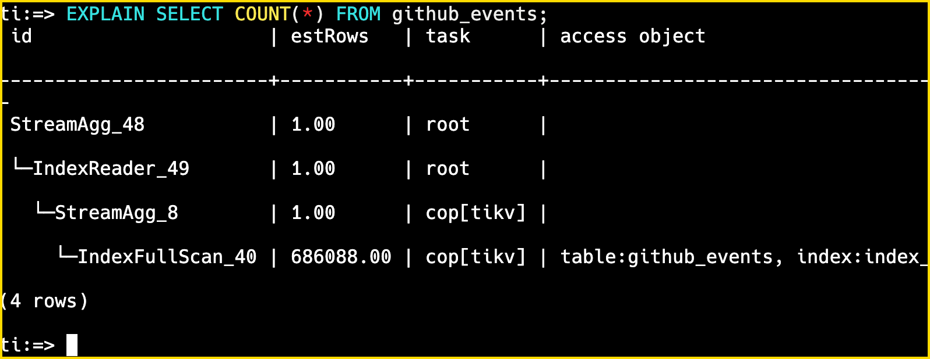
Let’s run some SQL Queries!
USE gharchive_dev;
SHOW TABLES;
SELECT COUNT(*) FROM github_events;
EXPLAIN SELECT COUNT(*) FROM github_events;
SELECT COUNT(*) FROM github_events;
TiDB server
TiKV server
Notes:
The EXPLAIN output tells us the TiDB Cloud will get the data from TiKV. Remember, TiKV is required for all TiDB clusters. Our diagram to the right only shows TiKV. That can’t be right because TiFlash was configured in our cluster. Is something wrong?

Slide 48
Let’s run some SQL Queries!
USE gharchive_dev;
SHOW TABLES;
SELECT COUNT(*) FROM github_events;
EXPLAIN SELECT COUNT(*) FROM github_events;
ALTER TABLE github_events SET TIFLASH REPLICA 1;
EXPLAIN SELECT COUNT(*) FROM github_events;
Notes:
Issue the ALTER TABLE statement then rerun the EXPLAIN.

Slide 49
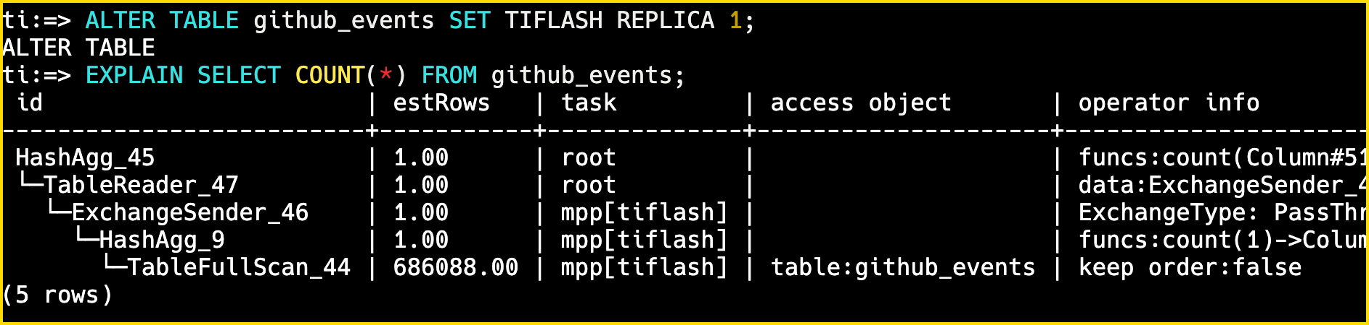
Let’s run some SQL Queries!
USE gharchive_dev;
SHOW TABLES;
SELECT COUNT(*) FROM github_events;
EXPLAIN SELECT COUNT(*) FROM github_events;
ALTER TABLE github_events SET TIFLASH REPLICA 1;
EXPLAIN SELECT COUNT(*) FROM github_events;
ALTER TABLE … SET TIFLASH REPLICA 1;
TiDB server
TiKV server
TiFlash server
Notes:
Notice that the EXPLAIN output has changed. TiDB is now using TiFlash. So, now we know that we must tell TiDB that a table needs TiFlash enabled. The reason for this is that not all tables need TiFlash and not enabling it saves disk space.
There is something important lurking under the covers here…

Slide 50
Let’s run some SQL Queries!
USE gharchive_dev;
SHOW TABLES;
SELECT COUNT(*) FROM github_events;
EXPLAIN SELECT COUNT(*) FROM github_events;
ALTER TABLE github_events SET TIFLASH REPLICA 1;
EXPLAIN SELECT COUNT(*) FROM github_events;
Insight: The TiDB server optimizer chooses which storage engine to use! You don’t even have to change your code!
ALTER TABLE … SET TIFLASH REPLICA 1;
TiDB server
TiKV server
TiFlash server
Notes:
Once we have enabled TiFlash for a table, the TiDB optimizer will choose which storage engine to use. You don’t have to do anything. Yes, that means you don’t need to change your queries!

Slide 51
Let’s run some SQL Queries!
USE gharchive_dev;
SHOW TABLES;
SELECT COUNT(*) FROM github_events;
EXPLAIN SELECT COUNT(*) FROM github_events;
ALTER TABLE github_events SET TIFLASH REPLICA 1;
EXPLAIN SELECT COUNT(*) FROM github_events;
ALTER TABLE github_events SET TIFLASH REPLICA 0;
EXPLAIN SELECT COUNT(*) FROM github_events;
Notes:
Let’s run two more commands. Can you guess what the ALTER TABLE command does?

Slide 52
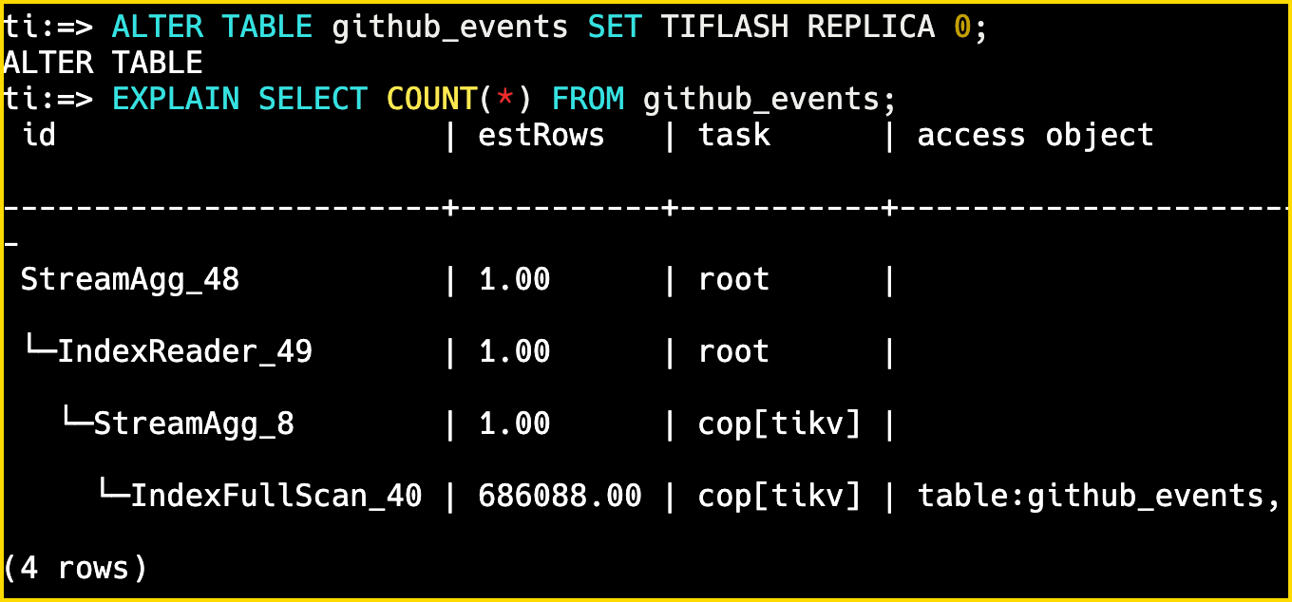
Let’s run some SQL Queries!
ALTER TABLE github_events SET TIFLASH REPLICA 0;
EXPLAIN SELECT COUNT(*) FROM github_events;
ALTER TABLE … SET TIFLASH REPLICA 0;
TiDB server
TiKV server
TiFlash server
Notes:
Well, the query has reverted back to using TiKV. Setting REPLICA to 0 deletes the TiFlash data.

Slide 53
What did we learn about TiDB and HTAP?
We learned:
The EXPLAIN command shows us how TiDB will satisfy a query.
By default, TiDB supports row-based storage via TiKV.
We can enable columnar storage (TiFlash) via an ALTER TABLE statement.
The TiDB optimizer chooses which storage engine to use for reads. We don’t have to do anything.
Notes:
The last bullet is HUGE.

Slide 54
Join me on the Playground!
Notes:
The TiDB Playground is a self-learning area of TiDB Cloud.

Slide 55
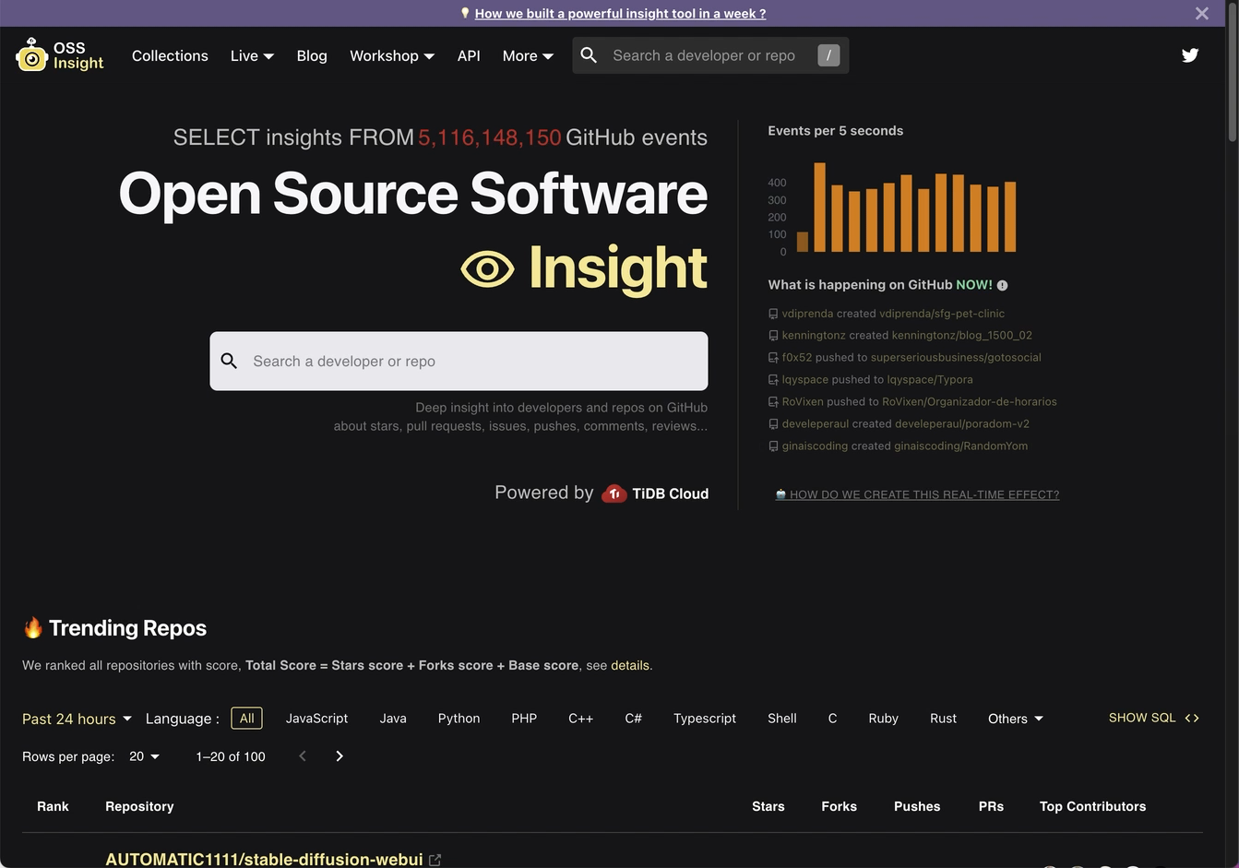
The Playground is Based On OSSInsight.io
Notes:
The playground data is based on the ossinsight.io web site. The site is built using TiDB Cloud.

Slide 56
Let’s go to the Playground
Click here to go to the Playground
Notes:
So, back to the TiDB Cloud web site. Click on Playground.

Slide 57
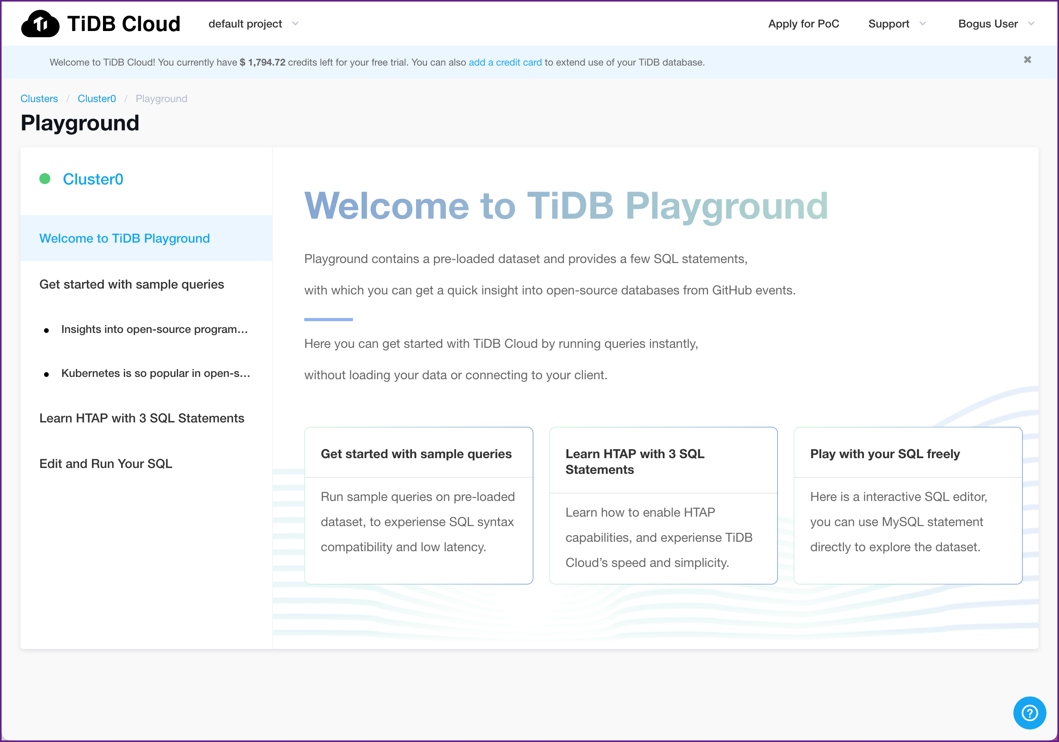
Let’s go to the Playground
Go through these activities at your own pace.
Notes:
Go through these activities. If you have a quest, holler.

Slide 58
The Playground is Based On OSSInsight.io
You can display the SQL the site uses
Notes:
The playground data is based on the ossinsight.io web site.

Slide 59
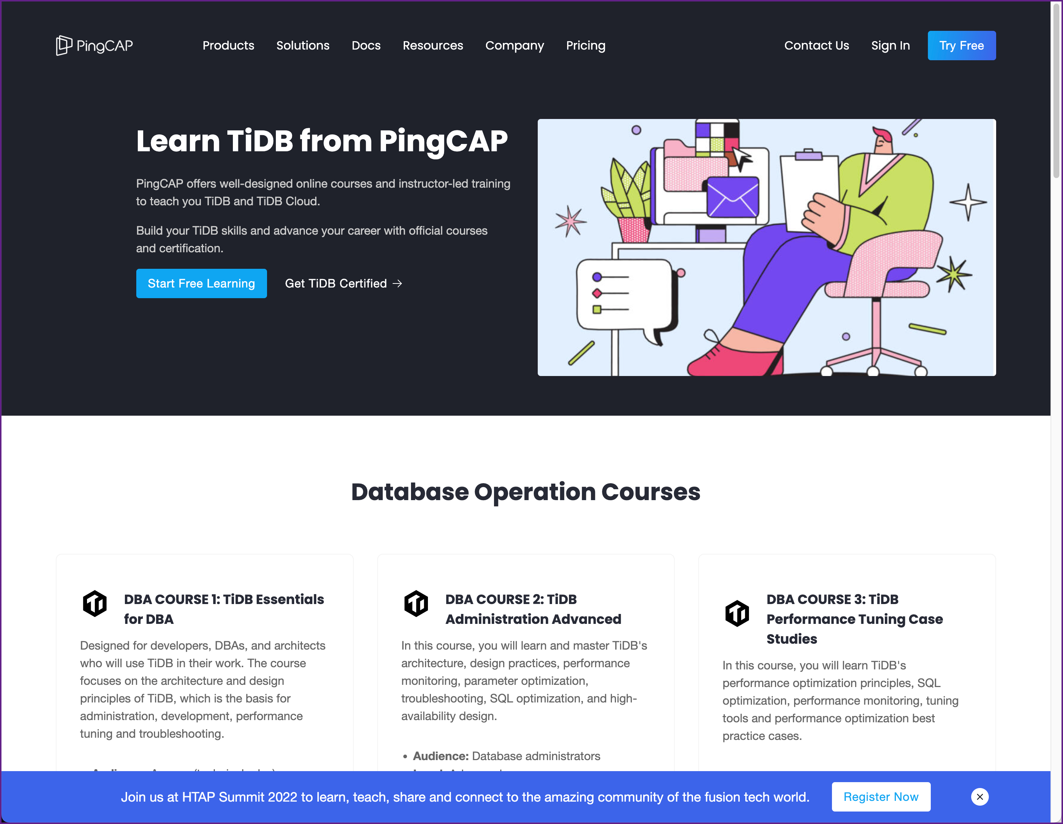
Next steps
We would love for you to:
Continue to learn and experiment with TiDB Cloud
pingcap.com/education

Slide 60
Next steps
We would love for you to:
Continue to learn and experiment with TiDB Cloud
Build something using with TiDB.

Slide 61
Next steps
We would love for you to:
Continue to learn and experiment with TiDB Cloud
Build something using with TiDB.
Present this workshop at a Lunch-and-Learn or Meetup. (We will give you the materials)

Slide 62
Thank you!

